Slide 1
Launching a New Nation
Chapter 7

Slide 2
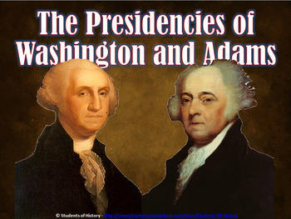
Section 1: Washington Leads A New Nation
The first President: George Washington
Had intended to retire
“Should the idea prevail that you would not accept the Presidency, it should prove fatal..to the new government.”
Electoral college: unanimous vote
Washington President/John Adams Vice President

Slide 3
The First Lady
Martha Washington: social first lady, behind the “scenes”
Republican Motherhood: a group that encouraged the involvement of women in this new nation..become active..Abigail Adams, Judith Sargent Murray
Teaching importance of being a citizen
More opportunities for women
More education for women
Perhaps, the first women’s movement
Too soon…country not ready, men not ready, women not ready

Slide 4
Republican Motherhood

Slide 5
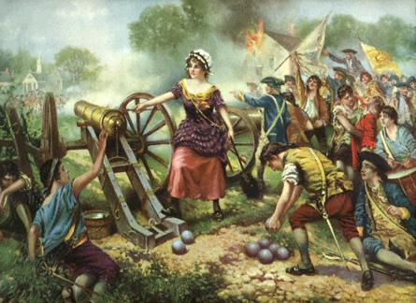
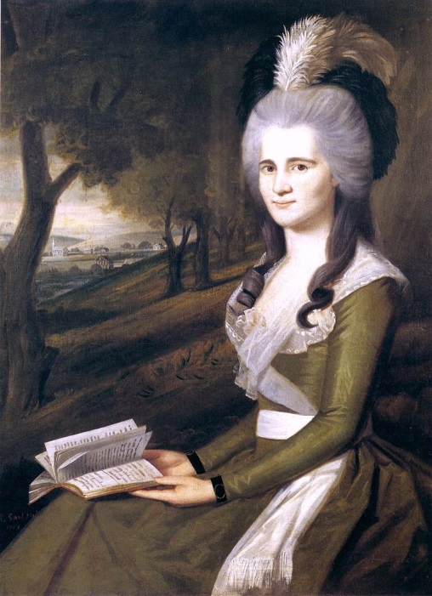
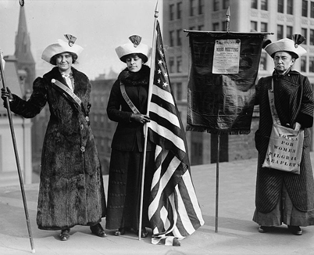
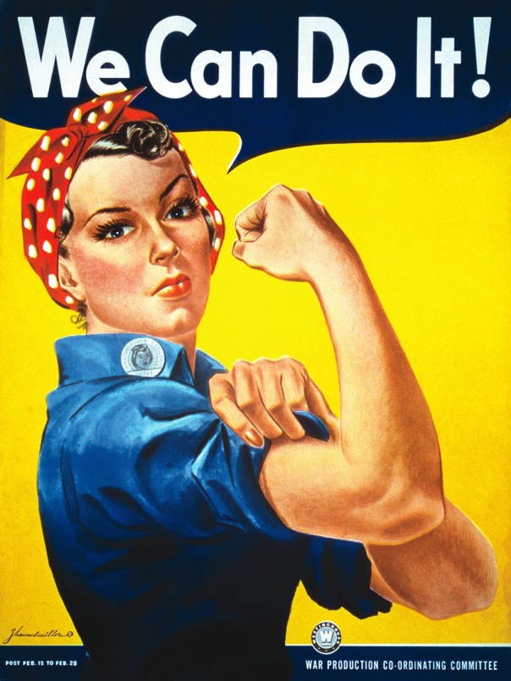
Picture Republican Motherhood

Slide 6
Organizing the Government
Policies/Procedures
How to begin????? Where to start???
“The first of everything in our situation will serve to establish precedent”
A need for advisors: Presidential cabinet
Secretary of State: Thomas Jefferson
Secretary of Treasury: Alexander Hamilton
Secretary of War: Henry Knox
Postmaster General: Samuel Osgood

Slide 7
Federal Judiciary
Judiciary Act of 1789: created a FEDERAL court system: three tier
Supreme Court…Circuit Courts…District Courts
Judges appointed by President, approved by Senate
'Gentlemen: I have always been persuaded that the stability and success of the national government, and consequently the happiness of the people of the United States, would depend, in a considerable degree, on the interpretation of its laws.

Slide 8
American Expectations
High expectations
Improved trade…strong economy
Limited government yet government protection
Issue: How to become ONE…UNITED???
United States already diverse interest….farmers, merchants, manufacturers
Each wanted government protection BUT AS IT BEST SUITED THEM

Slide 9
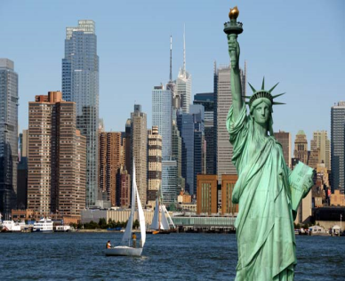
NEW YORK CITY: A SYMBOL
New York City: first capital of US
“Spirit of the Nation”: growth, strong economy, sense of energy, up and moving
1792: Wall Street: agreement signed: foundation for New York Stock Exchange…another image
New York City: potential of a new nation

Slide 10
Objective: To examine how the new U.S. government began.
Do Now: What problems did our nation face after the ratification of the Constitution?
Early American Problems
I. People were more loyal to their state than to the country.
II. People questioned the Constitution. (since the Articles of Confederation didn’t work)
III. People worried about the British and the French.
IV. The nation was severely in debt.

Slide 11
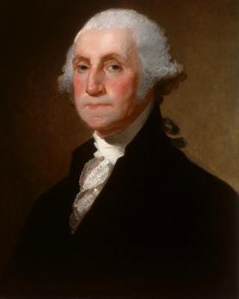
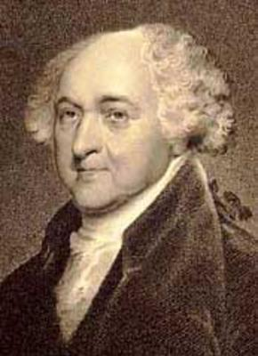
Organizing a New Government
Audio – The President’s March (1789)
In 1789, George Washington was inaugurated as the nation’s first President.
John Adams was the first Vice-President.

Slide 12
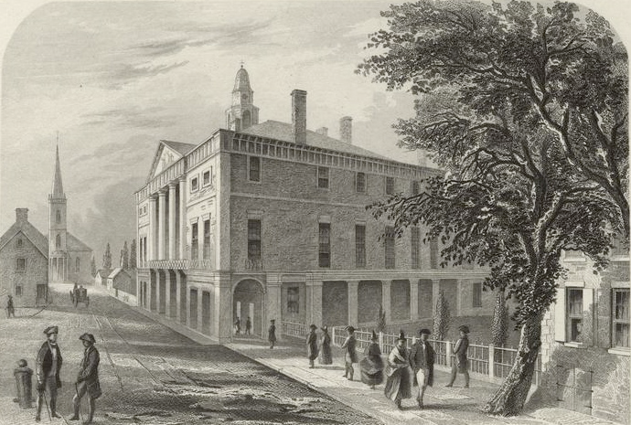
New York City was the first capital of the U.S.
Federal Hall, seen here in 1789, was originally constructed as a City Hall for New York in 1699.

Slide 13
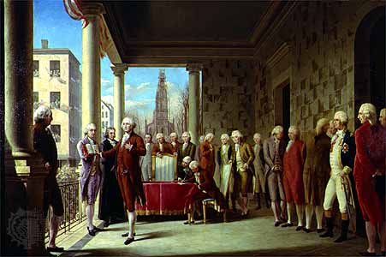
Oil painting of George Washington’s first inauguration by Ramon de Elorriaga from about 1899

Slide 14
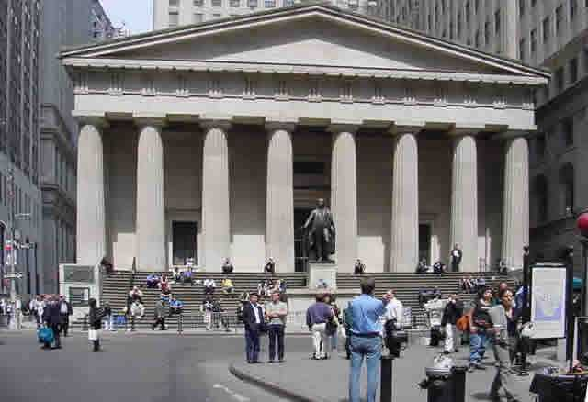
Federal Hall, New York City

Slide 15
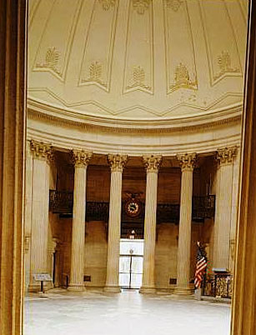
Rotunda, Federal Hall, New York City

Slide 16
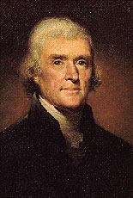
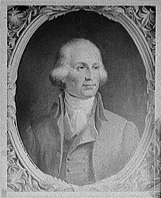
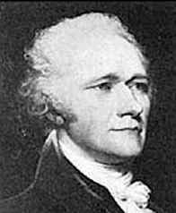
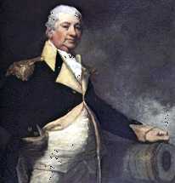
Washington appointed four men to his first Cabinet.
Secretary of State Thomas Jefferson
Postmaster General Samuel Osgood
Secretary of the Treasury Alexander Hamilton
Secretary of War Henry Knox

Slide 17
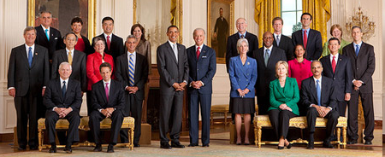
President Obama’s Cabinet
The Cabinet includes the Vice President and the heads of 15 executive departments — the Secretaries of Agriculture, Commerce, Defense, Education, Energy, Health and Human Services, Homeland Security, Housing and Urban Development, Interior, Labor, State, Transportation, Treasury, and Veterans Affairs, as well as the Attorney General.
The following positions have the status of Cabinet-rank: White House Chief of Staff, Environmental Protection Agency, Office of Management & Budget, United States Trade Representative, United States Ambassador to the United Nations, Council of Economic Advisers

Slide 18
The Federal Court System
In 1789, Congress passed the Judiciary Act.
Supreme Court
Circuit Court
District Court

Slide 19
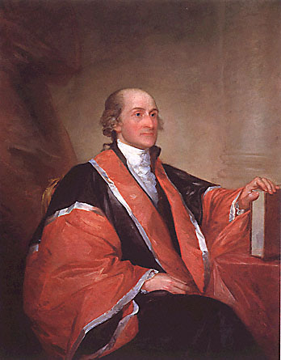
The Supreme Court
John Jay was named the first Chief Justice of the Supreme Court in 1789.
Today, the Supreme Court consists of one Chief Justice, and eight Associate Justices.
Chief Justice John Jay

Slide 20
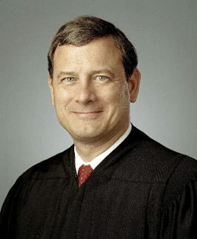
John Roberts is the current Chief Justice.

Slide 21
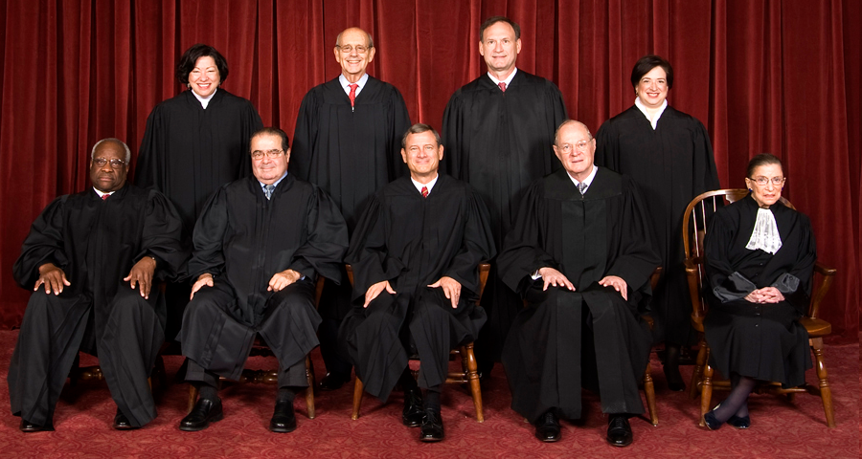
Current Supreme Court
(top row, left to right) Sonia Sotomayor, Stephen Breyer, Samuel Alito and Elena Kagan (bottom row, left to right) Clarence Thomas, Antonin Scalia, Chief Justice John Roberts, Anthony Kennedy and Ruth Bader Ginsburg

Slide 22
Section 2: Hamilton and National Finances
Alexander Hamilton: Secretary of Treasury
Issue: National Debt…US new country…How could they possibly repay the debt
$11.7 million to foreign countries
$40.4 million to US citizens
Taxes and bonds: The only two ways
Bonds: certificates sold by government and then bought back later for a higher price
Here comes the speculators
Hamilton’s plan: pay foreign debt NOW and gradually repay the value of the bonds

Slide 23
Finances
Jefferson disagrees: not fair to those who had already sold their bonds at a lower price
States debts: $25million
Hamilton: federal government should pay $21.5 million of the debt
Southern states: NO…many had already repaid their debts
“Worm on the hook”…move the national capital….Philadelphia until 1791 and then permanently to Washington DC on Potomac River

Slide 24
Jefferson Opposes Hamilton
Differing views about democracy: Who should hold the power? Federal government or states?
Hamilton: Strong federal government
Jefferson: States should retain their power
Seeds of political parties****
Economic differences: Hamilton: manufacturing, trade, protective tariffs
Jefferson: agrarian society, farming
“Our governments will remain virtuous for many centuries; as long as they are chiefly agricultural..”
North vs South

Slide 25
A National Bank
Hamilton: Need for a National Bank
1. Safe deposit of government’s money
2. Bank would make loans to government/business
3. National mint: coining of money
Charter: 20 years/must be renewed
States should create state banks
Jefferson/Madison: too much power to federal government/Constitution does not allow a federal bank
Hamilton: Article I, Section 8, Clause 18: Elastic Clause
Hamilton: Loose constructionist
Jefferson: Strict constructionist
Bank of the United States: 1791

Slide 26
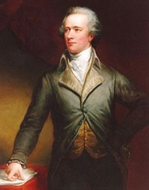
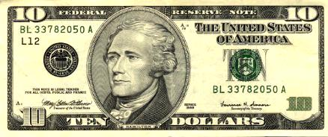
Objective: To analyze the importance of Hamilton’s economic plan.
Do Now: After becoming Secretary of the Treasury, Alexander Hamilton faced a nation in severe debt. Why was the U.S. in such debt?
Alexander Hamilton, first Secretary of the Treasury
Notes:
Helpful Hint:
View the enclosed activity that accompanies this presentation.

Slide 27
Hamilton and the National Debt
The U.S. was in debt.
Foreign debt – money owed to foreign nations such as Spain and France
Domestic debt – money owed to American citizens
The U.S. had borrowed money from its citizens in order to pay for the Revolutionary War through the sale of bonds.
Many citizens thought that the government would never be able to pay back their debt. Therefore, they sold their bonds to speculators at a loss.

Slide 28
Hamilton’s Economic Plan
Alexander Hamilton wanted to restore people’s faith in the U.S. economy by doing the following:
pay back all federal and state bonds
combine all state and federal debts into one huge national debt
Southerners such as James Madison hated this plan because:
most Southern states had already paid their debts
most speculators, who became rich, lived in the North

Slide 29
Hamilton’s Compromise
The South
agreed to…
The North
agreed to…
…allow the federal
government to take
over the debts
of the northern states.
…move the capital of
the U.S. to the South.
(Washington, D.C.)

Slide 30
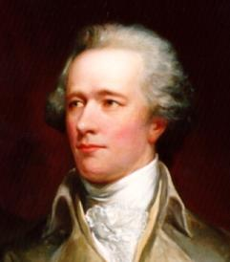
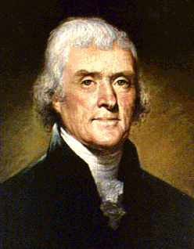
Objective: To analyze the differences between the first political parties.
Alexander Hamilton
Thomas Jefferson
Federalists
Democratic - Republicans

Slide 31
Hamilton and Jefferson: Differing Views
Alexander Hamilton
Thomas Jefferson
Favored trade, manufacturing and cities
Favored farmers and rural communities
Believed that the federal government should have more power than the states
Believed that states should have more power than the federal government (state’s rights)
Believed in a loose interpretation of the Constitution
Believed in a strict interpretation of the Constitution
was pro-British
was pro-French

Slide 32
First Political Parties
Federalists
Democratic Republicans
led by Alexander Hamilton
led by Thomas Jefferson
strong central government led by industry and the wealthy
strong state governments led by the “common man”
emphasis on agriculture
“Cultivators of the earth are the most valuable citizens.” – Thomas Jefferson
emphasis on manufacturing, shipping, and trade
loose interpretation of the Constitution
strict interpretation of the Constitution
favored the national bank
opposed the national bank
favored protective tariffs
opposed protective tariffs
pro-British
pro-French

Slide 33
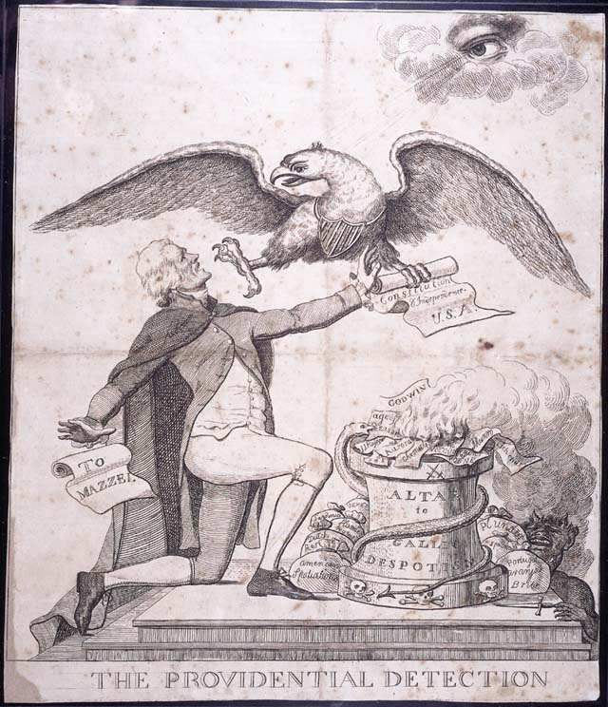
The Providential Detection 1797-1800.
Thomas Jefferson kneels before the altar of Gallic despotism as God and an American eagle attempt to prevent him from destroying the Constitution. Jefferson's alleged attack on George Washington and John Adams in the form of a letter to Philip Mazzei falls from his pocket. Jefferson is supported by Satan, the writings of Thomas Paine, and the French philosophers.

Slide 34
Am I a Federalist or a Republican?
Francois Goulet
Farmer from Georgia
5th grade education
2. Brandon Smith
Lawyer from Boston, MA
College graduate
3. John Marshall
Virginia planter
College graduate
Future Chief Justice of the Supreme Court
Believed that the judicial branch was too weak
4. Hans Gruber
German immigrant
Pennsylvania farmer
5. Sally Moore
Mother of five
Employee of a Massachusetts textile mill
6. James Prescott
Banker from Delaware
Member of the Delaware state legislature
7. Mary Worthington
Merchant from South Carolina
Sells mainly European products
Notes:
Helpful Hint:
Have your students complete the reverse side of the notes using their notes as a guide and use the slides that follow to go over the answers.

Slide 35
Am I a Federalist or a Republican?
Francois Goulet
Farmer from Georgia
5th grade education
Republican
2. Brandon Smith
Lawyer from Boston, MA
College graduate
Federalist

Slide 36
Am I a Federalist or a Republican?
3. John Marshall
Virginia planter
College graduate
Future Chief Justice of the Supreme Court
Believed that the judicial branch was too weak
Federalist
4. Hans Gruber
German immigrant
Pennsylvania farmer
Republican

Slide 37
Am I a Federalist or a Republican?
5. Sally Moore
Mother of five
Employee of a Massachusetts textile mill
Federalist
6. James Prescott
Banker from Delaware
Member of the Delaware state legislature
Republican

Slide 38
Am I a Federalist or a Republican?
7. Mary Worthington
Merchant from South Carolina
Sells mainly European products
Republican

Slide 39
Section 3: Challenges for the New Nation
French Revolution: 1789: US had served as a model, rebellion against the king, wanted a republican government
A republican government is one in which the political authority comes from the people. In the United States, power is given to the government by its citizens as written in the U.S. Constitution and through its elected representatives.
Americans take side…support or not to support
OH NO…France and Great Britain go to war…Who should US support? Great Britain? France? Neutral?
Neutrality Proclamation: “The duty and interest of the United States require that they should with sincerity and good faith adopt and pursue a conduct friendly and impartial towards the belligerent powers.”
Disagreement! Did Washington have the power to issue such a statement?

Slide 40
The French Question
Edmond Genet: French representative to US..ambassador….tried to persuade American sailors to help French
Privateers: private ships hired by a country to attack its enemies.
Washington told Genet he was “out of line”
Jefferson strongly disagreed with policy of neutrality…US had an obligation to help the French
Hamilton was US to help the British…a strong trading partner…question of economics

Slide 41
Jay’s Treaty
Problem…British were seizing American ships..
Washington sent John Jay to Great Britain to work out a compromise…neither country wanted another war
Jay’s Treaty
A. British would pay damages for seized ships
B. British would abandon forts on northwestern frontier
US would pay debt owed to Great Britain
Treaty very controversial…best that could be done
Ratified by the Senate

Slide 42
Pinckney’s Treaty
Spain becomes a problem: closed the port of New Orleans to all American trade
Thomas Pinckney wad sent to negotiate a treaty with Spain
A. Reopen New Orleans to American trade
B. Give US right of deposit: allow US to transfer goods without paying a fee
Pinckney Treaty
a. Border between US and Florida: 31 N Latitude
b. Reopen New Orleans for trade
c. US given right of deposit
US gets what it wants

Slide 43
Conflict in the Northwest Territory
Where is the Northwest Territory in 1790?
THE LURE OF LAND: American settlers moving into Northwest Territory: Indian occupation: Conflict
General Anthony Wayne: Battle of Fallen Timbers
Treaty of Greenville:
A. US gets Indian lands in Northwest Territory
B. Safety of US citizens guaranteed
C. Indians received $20,000 in GOODS????
Once again US gets what it wants and someone expense!

Slide 44
The Whiskey Rebellion
Congress passed a TAX on American made whiskey.
Hamilton’s plan to reduce the debt
How far could federal government dictate policy over the states?
People in Western States (western Pennsylvania) felt tax targeted them….corn into whiskey…they made it so they should keep the benefits ($$$$)
Washington issued proclamation: OBEY THE LAW
Whiskey Rebellion: protest turn violent…a challenge to federal authority
Washington: Constitution is law of the land…Congress has the DELEGATED power to tax
Washington HIMSELF led military action to stop rebellion…New role as Commander-in-Chief
Rebellion ended without a fight

Slide 45
Objective: To examine the formation of the national bank, the tariff proposal, and the Whiskey Rebellion.
Do Now: Why were most Southerners against Alexander Hamilton’s economic plan?
1) Most Southern states had already paid their debts.
2) When bondholders were paid back, it benefited Northern speculators at the expense of Southerners.

Slide 46
Strengthening the Economy
At the request of Alexander Hamilton, Congress passed a bill in 1791 setting up a national banking system.
The Bank of the U.S. was able to:
- print paper money
- use paper money to pay its bills
- make loans to farmers and businesses

Slide 47
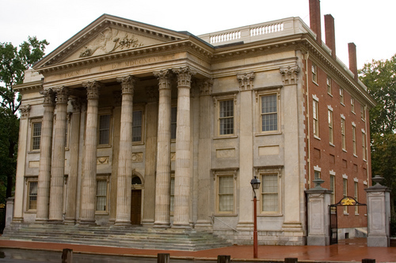
First Bank of the United States, Philadelphia, PA

Slide 48
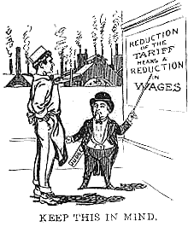
Tariff Proposal
Hamilton proposed that Congress pass a tariff on all imported goods.
Tariff – tax on imported goods
According to the artist, reducing tariffs, or import taxes, would reduce people’s salaries. How is this possible?
The idea is that reducing tariffs would cause people to buy more imported goods. In order to compete, domestic companies would have to lower their prices, hurting their ability to make a profit. As a result, companies then cut salaries and lay off people to make up for their loss in profits.
Judge,
June 29, 1912

Slide 49
The benefits
of tariffs:
they raise money
for the government
foreign goods
are made more
expensive
they help
Americans
keep their jobs
people buy more
U.S. goods

Slide 50
Other Types of Taxes
Sales tax –
a tax charged at the point of purchase for certain goods and services
I-Pod Touch 32 GB
Retail Price: $271.99 at Best Buy
+
Memphis, TN Sales Tax =
(for example)
9.45%
X
9.45
=
Retail Price: $271.99
271.99
100
+
Sales Tax: $25.70
100 X
=
2,570.30
Total Price = $297.69
100
100
100
2,570 30
.
.
Q: How much will the I-Pod cost in total?
X =
25.70 (sales tax)
Notes:
Helpful Hint:
Change the numbers to fit your own region’s sales tax.

Slide 51
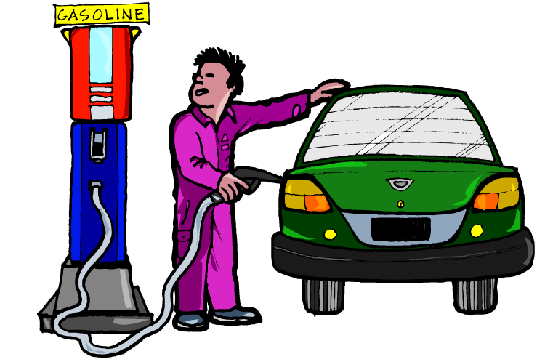
Other Types of Taxes
Excise tax –
a tax not directly applied by the government. The producer or merchant is charged a tax who then pays the government.
Q: If this man is paying $3.00 per gallon and he pumps 10 gallons, how much will it cost him?
Q: So, did he pay any taxes on his purchase?
A: $30.00
A: Yes! He paid an excise tax, which was already included in the price of the gasoline. It is up to the gas station owner to send the tax money to the government.

Slide 52
Other Types of Taxes
Excise tax –
a tax not directly applied by the government. The producer or merchant is charged a tax who then pays the government.
The state excise tax on gasoline is 21 cents per gallon in Tennessee .
Q: Therefore, if he spent $30.00 on 10 gallons of gas, how much did he pay in taxes?
A: .21 X 10 =
$2.10
Notes:
Helpful Hint:
Use the link provided to locate your own local excise tax on gasoline and make the necessary changes.

Slide 53
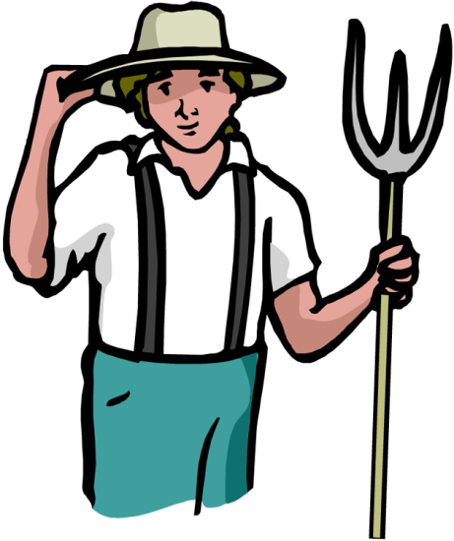
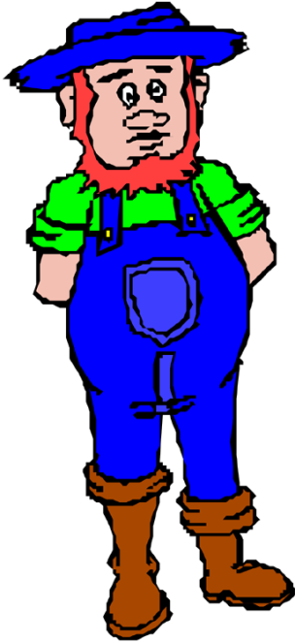
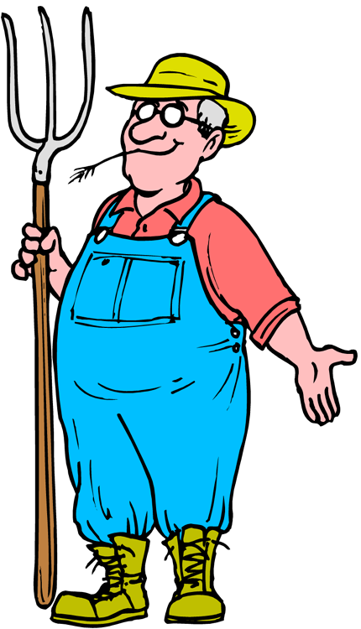
Why would farmers be mad about a tax on liquor?
Whiskey Rebellion
• In 1791, Congress taxed all liquor made and sold in the U.S.
The corn that we grow is used to make whiskey.
If whiskey is taxed, the price will go up and less people will buy it.
Liquor producers won’t have to buy so much corn from us.
Therefore, farmers like us will lose a lot of money because of this liquor tax!

Slide 54
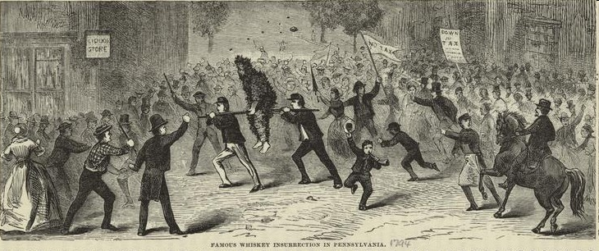
• Thousands of farmers rebelled against the tax.
"Famous whiskey insurrection in Pennsylvania", an illustration from Our first century: being a popular descriptive portraiture of the one hundred great and memorable events of perpetual interest in the history of our country by R. M. Devens (Springfield, Mass, 1882).

Slide 55
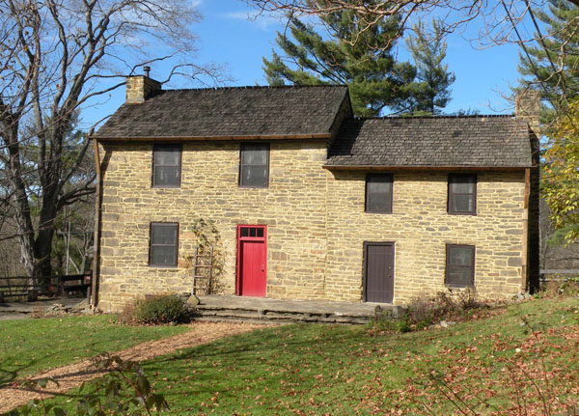
Picture of the James Miller House where, in 1794, the first gunshots of the Whiskey Rebellion were fired. Today, the homestead is listed on the National Register of Historic Places.

Slide 56
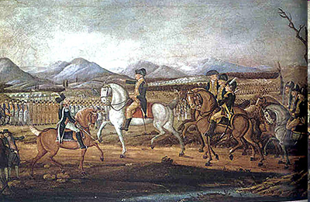
• Pres. Washington sent about 13,000 members of state militias to restore order.
The painting depicts George Washington and his troops near Fort Cumberland, Maryland, before their march to suppress the Whiskey Rebellion in western Pennsylvania.

Slide 57
"...if the laws are to be so trampled upon with impunity, and a minority...is to dictate to the majority, there is an end put at one stroke to republican government...for some other man or society may dislike another law and oppose it with equal propriety until all laws are prostrate, and everyone will carve for himself." - George Washington's observation about the Whiskey Rebellion
* The Whiskey Rebellion proved to Americans that the new government would act firmly in times of crisis.
Notes:
Helpful Hint:
Compare the Whiskey Rebellion with Shays’ Rebellion. Ask the class how they differed symbolically.
(Shays’ Rebellion symbolized the weakness of the Articles of Confederation while the Whiskey Rebellion symbolized the strength found within the Constitution.)

Slide 58
Washington Says Farewell
1796: Washington decides not to run for a third term: sets a precedent until FDR: 22nd. Amendment
Warnings:
A. Entangling alliances with foreign countries
B. Political parties: need for political unity
C. Too much debt is not good
Strength of the nation is its PEOPLE!

Slide 59
John Adam’s Presidency
Presidential election 1796: formation of political parties/factions
Federalist Party: Hamilton: strong federal government/support business/trade/merchants
Federalist nominate: John Adams/Thomas Pinckney
Democratic-Republican Party: Jefferson and Madison/limit power of federal government/more states’ rights/nominate Thomas Jefferson/Aaron Burr
Taking sides
A. Business/merchants in cities favored Federalists..Where were most of the cities?????
B. Farmers in remote areas favored Democratic-Republicans..Where were most of the farmers?
ADAMS WINS THE ELECTION OF 1796…but who was Vice-President?? Amendment 12

Slide 60
President Adams and the XYZ Affair
Adams follows Washington…big shoes to fill…has to earn respect
Qualities: hard-working, honest, intelligence, civic leader
Goal: reestablish a working relationship with France
Need to protect American shipping
French foreign minister, Talleyrand, would not speak to US representatives
THREE French agents told US representatives that Talleyrand would only talk them when paid $250,000 BRIBE…Plus…French government wanted a loan of $12million
Three agents…X,Y,Z…became known as XYZ Affair
“Millions for defense, but not one cent for tribute!”
United States not happy with France..War????

Slide 61
Leaning toward war…or NOT
Adams reacts: increase the naval fleet of ships and called for a “standing army”…Congress agrees
Adams hoping to avoid war
Federalist not happy with Adams…his own party
American and French fighting in the Caribbean…war still avoided

Slide 62
Alien and Sedition Acts
Federalist favored war…Democratic Republicans favored France
Name calling: “democrats, mobocrats, and all other kinds of rats.”
1798: Alien and Sedition Acts passed: series of acts..How did this act get passed????
Sedition Act: forbade anyone from publishing or voicing criticism of the government…What happened to Amendment 1?
Madison and Jefferson challenged power of the federal government…wrote the Kentucky and Virginia Resolutions…Alien and Sedition Acts unconstitutional, federal government could not interfere in STATE affairs…FEDERAL GOVERNMENT VS STATE GOVERNMENTS
WHO IS DRIVING THIS CAR?????????????????????

Slide 63
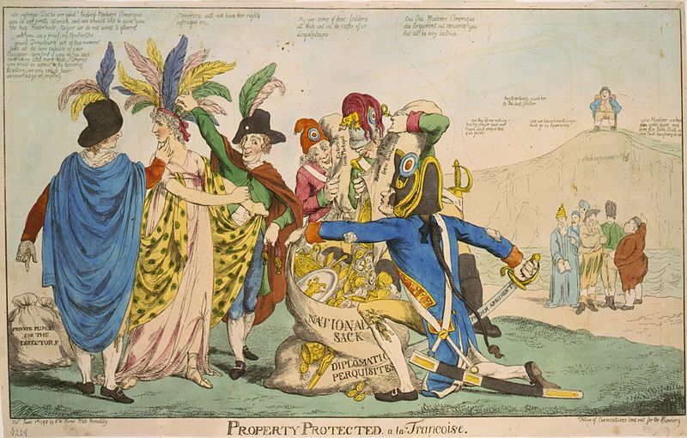
Objective: To examine the XYZ Affair and the causes and effects of the Alien and Sedition Acts.
British satire of Franco-American relations after the XYZ Affair in May of 1798; 5 Frenchmen plunder female "America", while six figures representing other European countries look on. John Bull sits laughing on "Shakespeare's Cliff.“ June 1, 1798

Slide 64
The XYZ Affair
The U.S. sent three people, Charles Pinckney, Elbridge Gerry, and John Marshall, to France to work on a peace settlement.
The three French officials, who became known as X, Y, and Z, demanded a bribe and a loan for France.
Angered and insulted, the Americans refused.

Slide 65
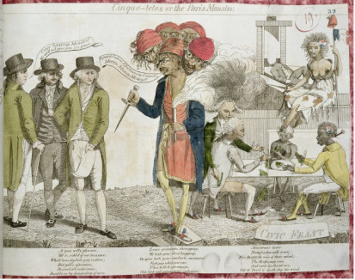
"Millions for defense, but not one cent for tribute."
"Millions for defense, but not one cent for tribute."
"Millions for defense, but not one cent for tribute."
The cartoon below depicts a five-headed monster, representing the Directory that ruled France in 1797, demanding payment of a bribe from the three American representatives.

Slide 66
What are the definitions of the following key terms?
alien
sedition
deport
a foreigner
stirring up a rebellion against a government
to expel, or kick out
Alien and Sedition Acts (1798)
– Federalist laws intended to stop Democratic-Republicans from gaining power.

Slide 67
Alien Act
(1798)
allowed the President to
deport any alien considered
dangerous to the country.
The number of years an
alien had to wait to
become a U.S. citizen
increased from 5 to
14 years.
These laws helped
stop immigrants
from voting for the
Democratic-Republicans.

Slide 68
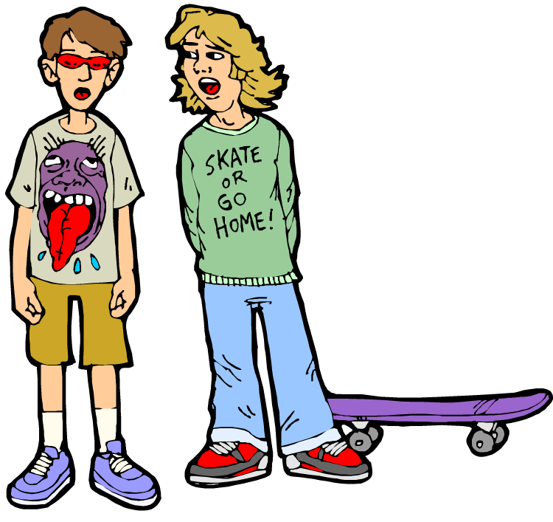
Sedition Act
(1798)
And illegal, too!
Yo, that’s wack!
Anyone found
guilty of sedition
could be fined
and sent to prison.
The law was aimed
at Democratic-Republican
newspapers.

Slide 69
Kentucky and Virginia Resolutions
Thomas Jefferson claimed that the Alien and Sedition Acts were unconstitutional.
KY and VA claimed that states had the right to nullify any federal law they believed to be unconstitutional. (state’s rights)
Nullify -
to cancel
The Federalists believed that only the Supreme Court could declare a law unconstitutional.
Video Summary (4:47)
Notes:
Helpful Hint:
If time allows, pause and discuss during the viewing of the video summary.

