Slide 1
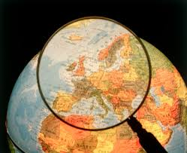
Where in the World
European Physical Features

Slide 2
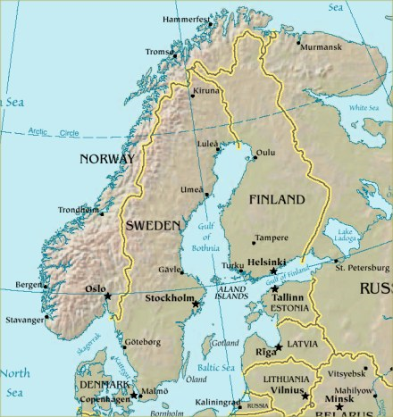
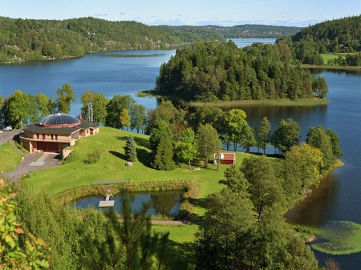
Europe Physical Features: Peninsulas
Peninsula: area of land that is surrounded by water on three sides
My peninsula includes the countries of Norway and Sweden and a small part of Finland.
I am surrounded by the Baltic Sea, North Sea, and Norwegian Sea.
25% of my land is located north of the Arctic Circle.
Who am I?

Slide 3
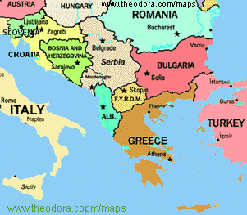
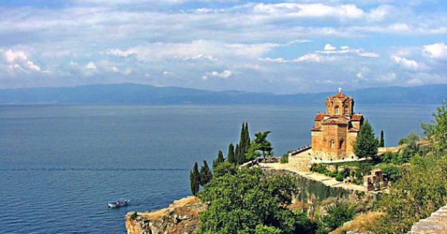
Europe Physical Features: Peninsulas
I am located in southeastern Europe.
I am surrounded by the Adriatic, Mediterranean, and Aegean Seas.
Countries on my peninsula include Albania, Bosnia, Bulgaria, Greece, Kosovo, Serbia, and Eastern Turkey.
I am very mountainous and have dense forest areas.
Who am I?

Slide 4
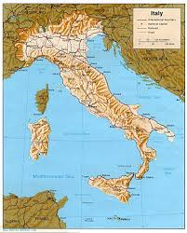
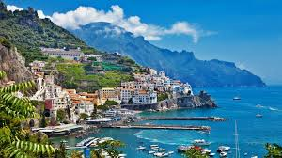
Europe Physical Features: Peninsulas
I am a boot shaped peninsula in Southern Europe
Italy is the major country on my peninsula
Holy See and San Marino are also found on my peninsula
I am surrounded by the Adriatic Sea, Ionian Sea, and Mediterranean Sea
Who Am I?

Slide 5
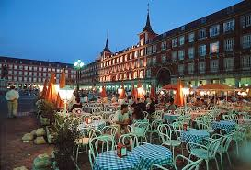
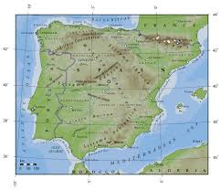
Europe Physical Features: Peninsulas
I am located on the southwestern tip of Europe
Countries on my peninsula include Spain, Portugal, and Andorra
I am surrounded by the Bay of Biscay, the Atlantic Ocean, and the Mediterranean Sea
The Pyrenees form a land barrier in the northeast that separates me from the rest of Europe
I am only 5 miles away from Africa at its nearest point
Who am I?

Slide 6
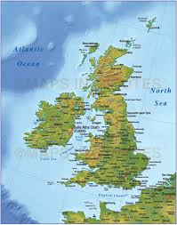
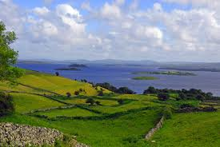
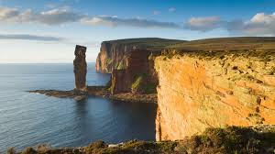
Europe Physical Features: Islands
I consist of two main islands – the United Kingdom and Ireland – as well as thousands of smaller islands
In the north and west there are mostly mountains, plateaus, and valleys
In the south there are low hills and plains
Ireland, often called the Emerald Isle, is an island known for its lush green land and cool, rainy weather
Who am I?

Slide 7
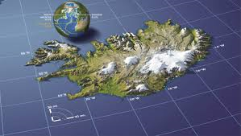
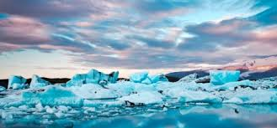
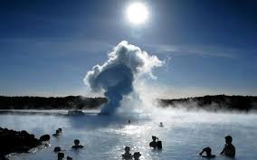
Europe Physical Features: Islands
I am located in the North Atlantic Ocean
I am actually the top of an underwater volcano – my island formed from hot lava that cooled and turned to rock
I am known for my many volcanoes, hot springs, and geysers
Because I am so far north I also have several glaciers – but grassy lowlands stretch along my coasts
Who am I?

Slide 8
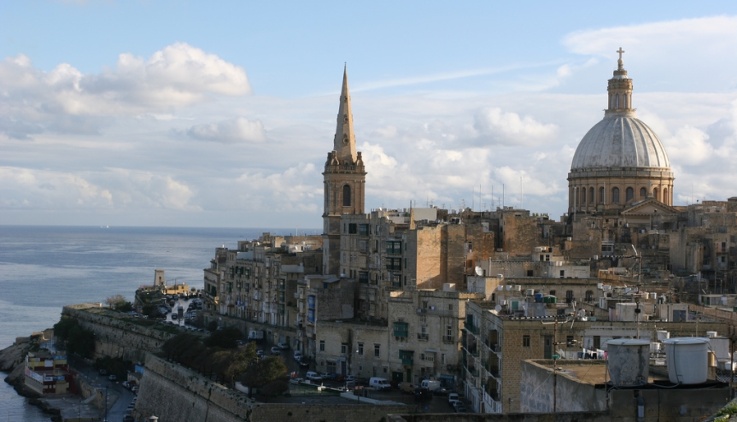
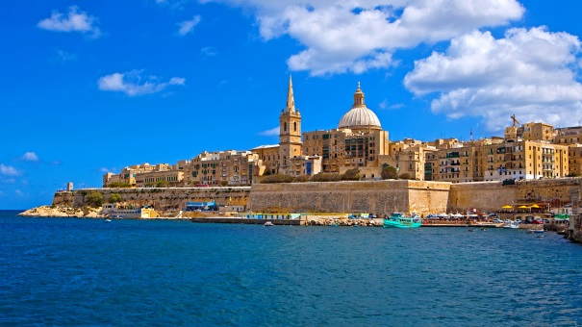
Europe Physical Features: Islands
1. Although I am called an island, I am really an archipelago made up of 7 islands.
I am located in the Mediterranean Sea
2. I can fit into the United States 30, 343 times.
3. I was probably once a part of Italy.
4. My beautiful location makes be ideal for movie productions
5. I do not have a single forest, mountain,or river.
Who am I?

Slide 9
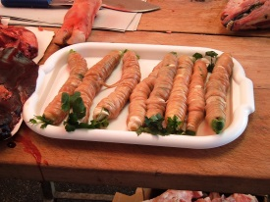
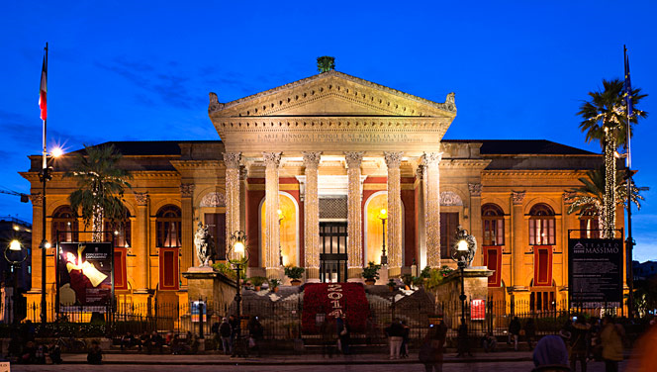
Europe Physical Features: Islands
1. I am located in the Mediterranean Sea.
2. According to Greek mythology ships that pass between myself and Calabria are in danger of being attacked by the sea monsters, Scylla and Charybdis.
3. My capital, Palermo, had been elected European capital of street food.
4. The tallest active volcano, Etna, is found on my island.
5. The largest Italian opera house, Teatre Massimo, is located on my island.
Who am I?

Slide 10
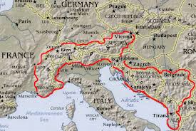
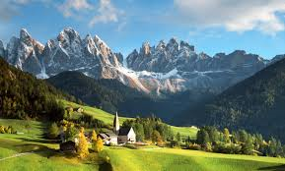
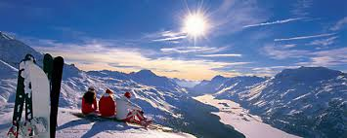
Europe Physical Features: Mountains
I stretch through France, Italy, Switzerland, and Austria
My high, snow-capped peaks are known throughout the world for their beauty
Mont Blanc is my tallest mountain at 15,781 feet high
Three of Europe’s largest rivers – the Rhine, the Rhone, and the Po – start in my mountains
Who am I?

Slide 11
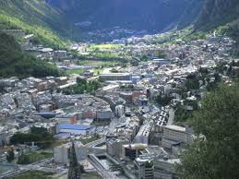
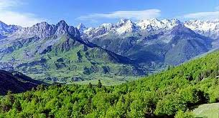
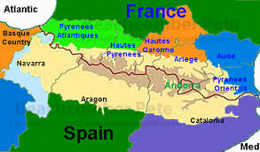
Europe Physical Features: Mountains
I stretch between France and Spain and separate the Iberian Peninsula from the rest of Europe
My mountain chain is about 270 miles long and 80 miles wide
Blocked by my mountains from the rest of Europe, Spain and Portugal developed stronger ties to Africa and the sea
The small country of Andorra lies among my peaks
Who am I?

Slide 12
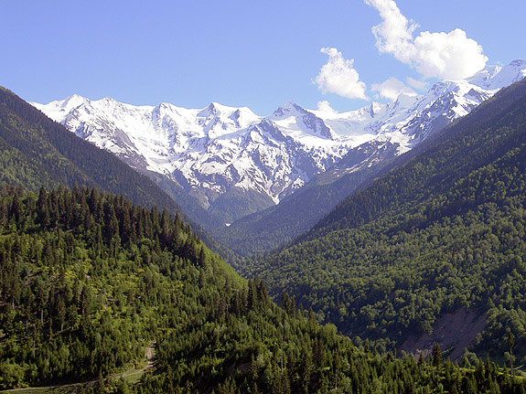
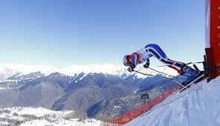
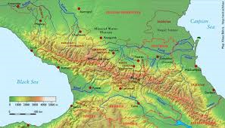
Europe Physical Features: Mountains
I am located along the border between southeastern Russia and the Asian countries of Azerbaijan & Georgia
Mount Elbrus, the highest mountain in Europe, is in my mountain range
Some of my mountains hosted events for the Sochi Olympic Games
My region is culturally diverse, with several ethnic groups that developed in relative isolation due to the difficult conditions for travelers.
Who am I?

Slide 13
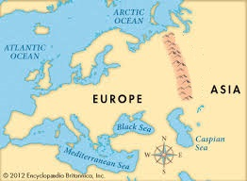
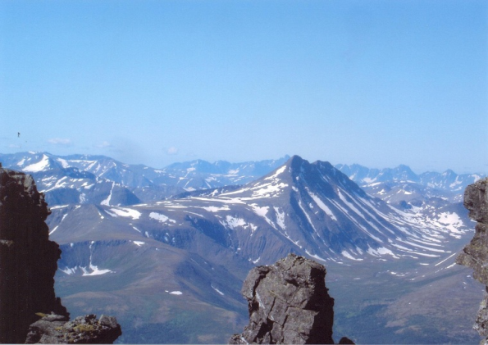
Europe Physical Features: Mountains
I run from north to south through Russia separating Europe from Asia
My mountains are some of the oldest in the world, some 250 to 300 million years old
I act as a natural barrier to winds from the Atlantic, so the region to my east, Siberia, is on average colder and dryer
Who am I?

Slide 14
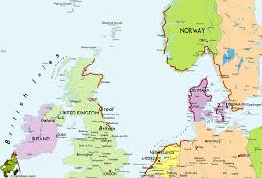
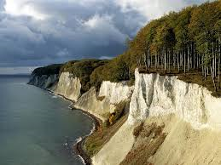
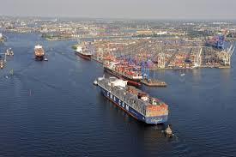
Europe Physical Features: Bodies of Water - Seas
Seas: bodies of water partly or entirely enclosed by land
I border the Scandinavian Peninsula and the British Isles
I am a shallow sea with a depth of less than 150 feet in some areas
I am one of the busiest shipping areas in the world with my shores touching 7 European countries – Norway, Great Britain, Denmark, Germany, the Netherlands, Belgium, and France
Who am I?

Slide 15
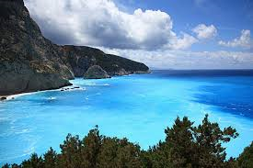
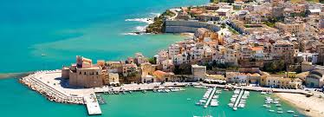
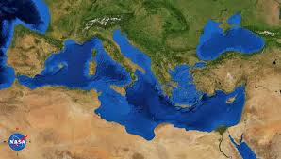
Europe Physical Features: Bodies of Water - Seas
I am almost completely surrounded by land with coastlines in 21 countries
Europe is to my north, Asia is to my east, and Africa is to my south
I am connected to the Atlantic Ocean by the Strait of Gibraltar
I have several islands in my waters, including Crete, Cyprus, Malta, and Sicily
Who am I?

Slide 16
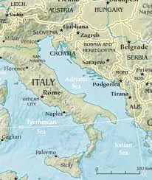
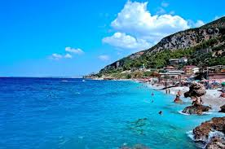
Europe Physical Features: Bodies of Water - Seas
I separate the Italian Peninsula from the Balkan Peninsula
My two major shorelines have a striking contrast, with the Italian coast being relatively straight with no islands, and the Croatian coast being more rugged and full of both large and small islands
Bari, Rijeka, and Venice are some of my chief ports, and my sea is well served by regional ferries
Who am I?

Slide 17
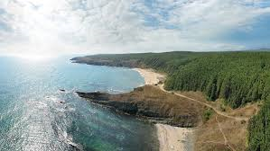
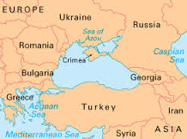
Europe Physical Features: Bodies of Water - Seas
I am located between southeastern Europe and western Asia
I border the European countries of Bulgaria, Romania, Ukraine, and Russia and the Asian countries of Turkey and Georgia
The Yalta Convention about WWII, between Churchill, FDR, and Stalin, was held in the city of Yalta on my northern coast
I was a busy waterway in the ancient world, with the Balkans to my west, Central Asia to my east, Mesopotamia to my south, and Greece to my south-west.
Who am I?

Slide 18
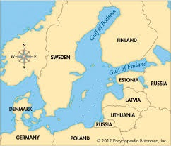
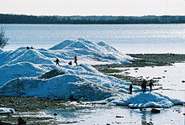
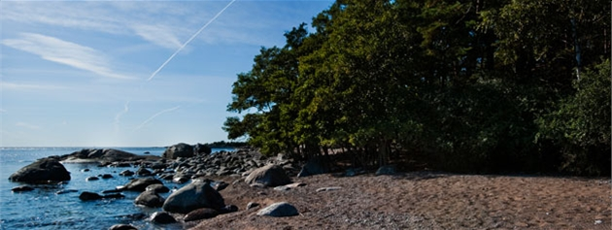
Europe Physical Features: Bodies of Water - Seas
I separate the Scandinavian Peninsula from the main land of Europe
The Norse (Scandinavian) merchants built a trade empire all around my coast and dominated my region during the Viking Age
The 3 countries on my eastern shore – Estonia, Latvia, & Lithuania – are nicknamed the “______ States”
During the winter, about 45% of my surface turns to ice
Who am I?

Slide 19
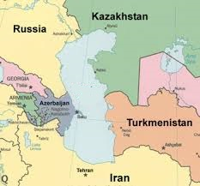
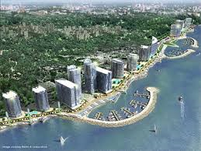
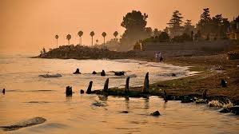
Europe Physical Features: Bodies of Water - Seas
I am a land-locked sea between Asia and Europe
I have characteristics of both seas and lakes and am commonly listed as the World’s Largest Lake
The Volga and Ural Rivers flow into me
I border several countries including Russia, Azerbaijan, Turkmenistan, Kazakhstan, and Iran
Who am I?

Slide 20
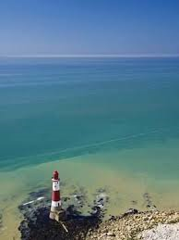
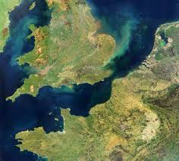
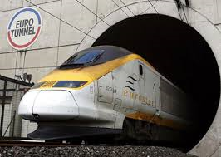
Europe Physical Features: Bodies of Water
I separate Great Britain from France and connect the North Sea to the Atlantic Ocean
I am the busiest commercial waterway in the world, with ferries, freighters, and fishing boats
I have a rail tunnel – nicknamed the “Chunnel” – built underwater connecting England and France for travelers
Who am I?

Slide 21
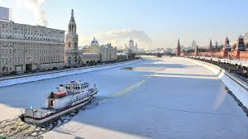
Europe Physical Features: Rivers
I flow through much of European Russia and played a significant role in Russian history and culture
I empty into the Caspian Sea and am Europe’s longest river
Several of Russia’s largest cities, including the capital, Moscow, are located near my banks
Most of my length in the north is frozen over for three months during the winter
Who am I?

Slide 22
Europe Physical Features: Rivers
I begin in the Swiss Alps at the Rheinwaldhoen Glacier
I flow through six countries – Switzerland, Liechtenstein, Austria, Germany, France, and the Netherlands – before reaching the North Sea
More than 40 castles and fortresses, that were built during the Middle Ages, are along my banks
I have been one of Europe’s most important transport routes since the Roman Empire
Who am I?

Slide 23
Europe Physical Features: Rivers
I flow for 1,785 miles from the Black Forest in Germany to the Black Sea - (Europe’s 2nd longest river)
I flow through or along the border of 10 countries: Germany, Austria, Slovakia, Hungary, Serbia, Croatia, Bulgaria, Moldova, Ukraine, and Romania
4 European capitals are located on my banks – Vienna, Bratislava, Budapest, and Belgrade
Hungary’s capital, Budapest, is one of Europe’s most beautiful cities and is sometimes referred to as the “Queen of the ______”
Who am I?

