Slide 1
Mesopotamia
“LAND BETWEEN THE TWO RIVERS”

Slide 2
Begin by looking, reading, and writing….
A time line: pp 82: write 5 statements based on the information pp 82—83
A map pp 84—85: write 5 statements based on the information based on the information on page 84—85…What is the title of the map?

Slide 3
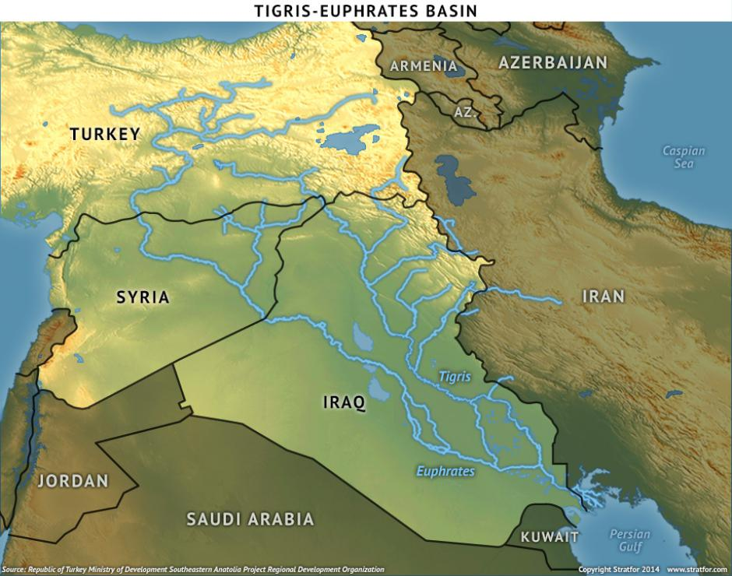
River Systems
River Systems: A major river(s) and tributaries that flow into the major river
River systems form valleys
River valleys location of permanent settlements
Four major river systems
Tigris-Euphrates: Southwest Asia
Nile River: Africa
Indus River: Southern Asia
Huang He: Eastern Asia

Slide 4
The Tigris and Euphrates
Civilization: Sumer: located in fertile crescent of Tigris and Euphrates River Valley: very fertile land
Tigris meets Euphrates: flow into Persian Gulf
Land between Tigris and Euphrates: Mesopotamia: “land between the two rivers”
Sumer: became first civilization of Mesopotamia

Slide 5
Need for Irrigation
Flooding: saint and demon: fertile soil but floods could destroy
Northern Mesopotamia: enough rainfall
North true of Southern Mesopotamia: hot sun..baked soil
Learned to make use of the river…irrigation…water the soil…store water
Building dikes to protect from floods
Dams: to control the flow of river water
Allowed for farming to become a way of life

Slide 6
Independent Sumerian City-States
The emergence of cities: Ur, Kish, Uruk, Eridu: grew to be powerful…cities of culture and achievement
Characteristics of a city-state
Independent
Walled city
Land around city
Own government
Population over 5,000…eventually 60,000
Individual city-states became part of civilization
Common language, writing, arts, and crafts among the entire civilization

Slide 7
Government and Religion
Government: made up of small group of leaders and a chief leader
Made laws, settle disputes, decided what work had to be done, waged war
Need for ONE leader: idea of monarchy: a government ruled by a king or queen
Monarchy passed on by a blood line
King had complete control: autocracy: rule by one
King had power, authority, legitimacy
Sumerians practiced polytheism: believe in many gods: one god for each natural event or element of life: god of agriculture, god of war, god of rain
Gods must be pleased: worshiped the gods in temples

Slide 8
Mesopotamian Achievements
Agricultural Techniques: innovations: new ways of doing tasks, problem solving: creative: innovative: Example: irrigation
From clay…copper…bronze
Each new way: innovation: life improved, more productive, benefits
Passing on information: almanacs…giving advice: planting, irrigation, crops,

Slide 9
Measurements
Land critical element of Sumerian life
How much do we have???....need for measurement
Iku or ikum: the field: an iku equaled 37,600 square feet
Frim iku to acre: one acre equals 43,560 square feet
Sumerian numbers based on 60…our number system developed FROM the Sumerian number system (hours, minutes, seconds)
Sumerian calendar: 360 days

Slide 10
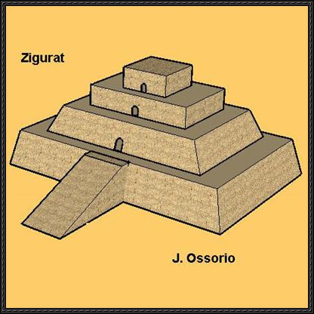
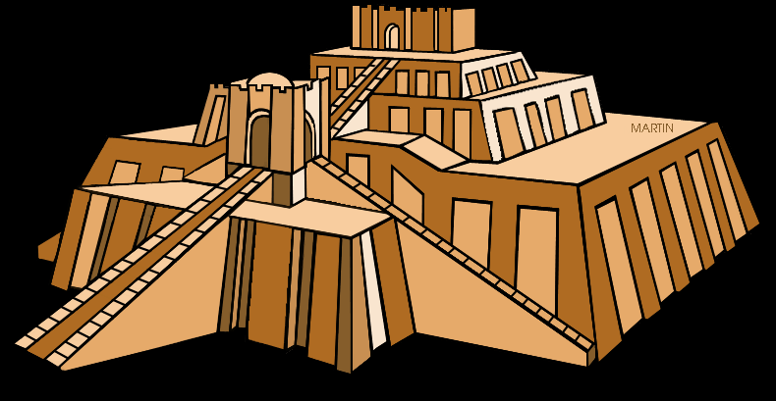
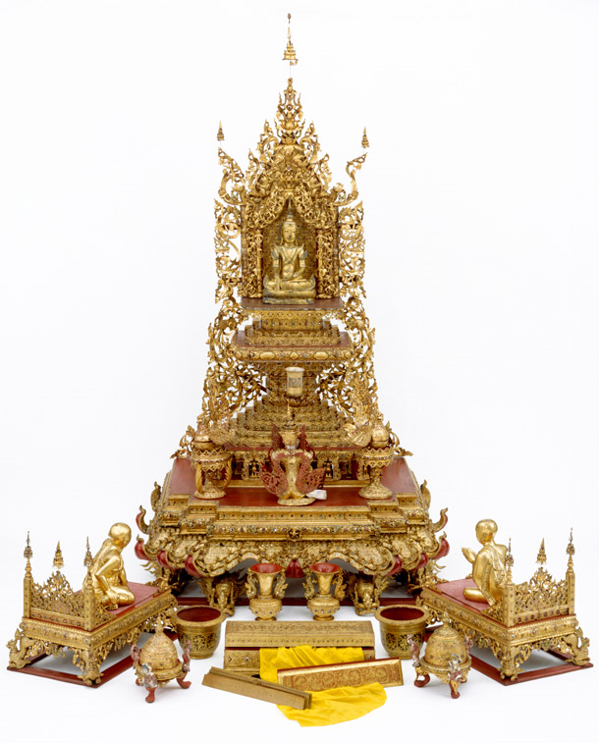
Buildings
Use what you have….few trees in southern Mesopotamia but plenty of MUD…make bricks out of mud
Higher your rank…higher your house, more detail
Ziggurat: Temple, highest and tallest building, as wealth and power grew so did ziggurat
Top of each ziggurat a shrine for city’s god
Other buildings built around the ziggurat…center of activity.

Slide 11
Transportation
Wheels: Sumerians attached wheels to carts: two-wheeled/four wheeled
Chariots pulled by donkeys or oxen
Use of caravans
Boat transportation: built like basket made from reeds and covered by animal skins: mast and sail in center: first sailboat
Also canoes

Slide 12
Writing and Literature
Sumerians: first written records: clay tablet in Kish: 3500 BC: picture symbol that recorded trade
Clay tablets found at Uruk: writing system: cuneiform: wedge shaped symbols: over 700 symbols
Scribes: those people who knew how to write: recorded history: very important

Slide 13
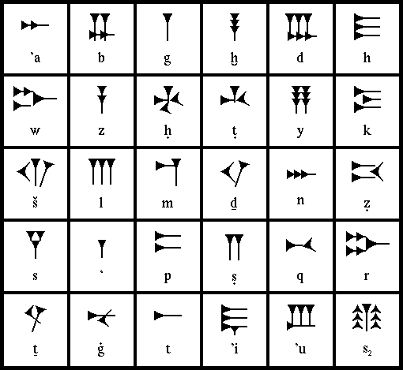
Your Turn
Make an alphabet in cuneiform. Your alphabet must have 20 symbols. Symbols should be in color. Then write 4 words using your alphabet. Each word must be at least 6 letters.
Grading:
Title: 5 points
Symbols: 40 points
Words: 40 points
Neatness: 10 points
Directions: 5 points
Total: ________/100 points

