Slide 1
Where in the World
European Physical Features

Slide 2
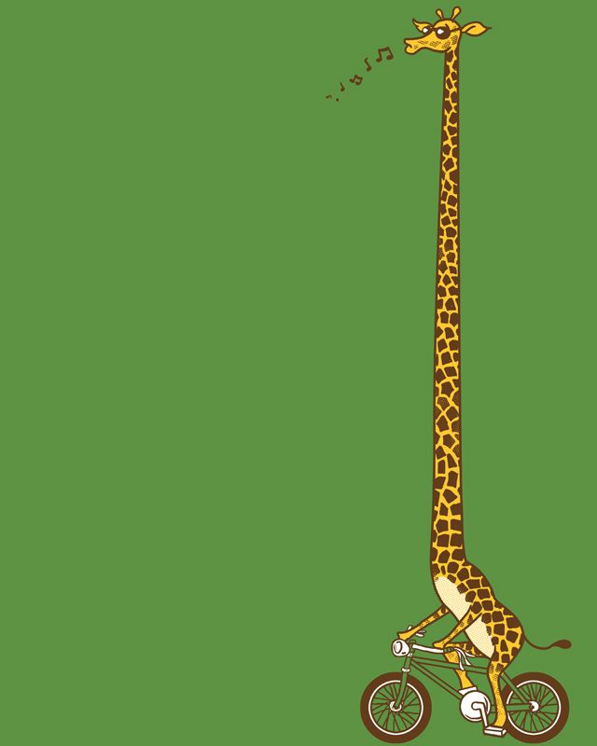
Geoffrey,
our lovable geography giraffe,
has decided to take a tour of European
Physical Features.
He is going to send us clues and pictures of his various stops to help us test our geographical skills.

Slide 3
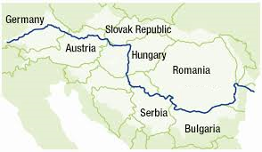
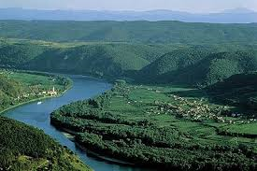
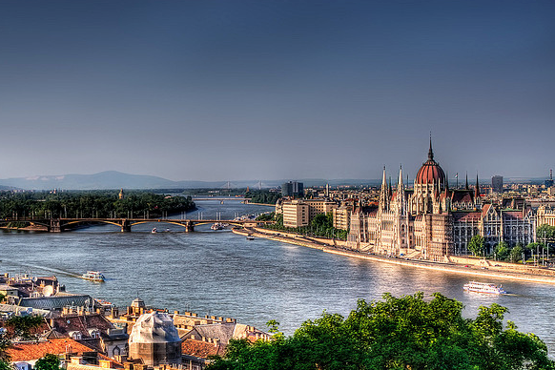
HERE ARE TODAY’S CLUES FROM GEOFFREY:
I flow for 1,785 miles from the Black Forest in Germany to the Black Sea and am Europe’s 2nd longest river
I flow through or along the border of 10 countries: Germany, Austria, Slovakia, Hungary, Serbia, Croatia, Bulgaria, Moldova, Ukraine, and Romania
4 European capitals are located on my banks – Vienna, Bratislava, Budapest and Belgrade
Hungary’s capital, Budapest, is one of Europe’s most beautiful cities and is sometimes referred to as the “Queen of the ____________”
WHERE IN THE WORLD IS GEOFFREY?

Slide 4
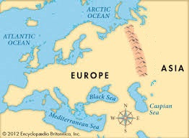
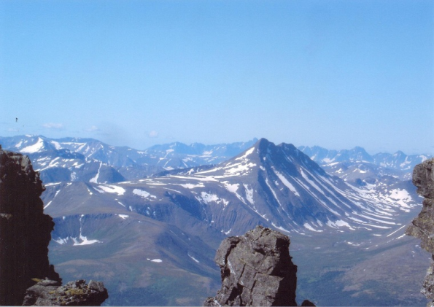
HERE ARE TODAY’S CLUES FROM GEOFFREY:
I run from north to south through Russia separating Europe from Asia
My mountains are some of the oldest in the world, some 250 to 300 million years old
I act as a natural barrier to winds from the Atlantic, so the region to my east - Siberia, is on average colder and dryer
WHERE IN THE WORLD IS GEOFFREY?

Slide 5
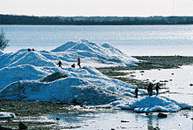
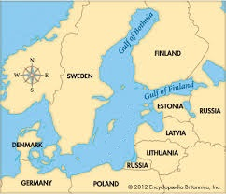
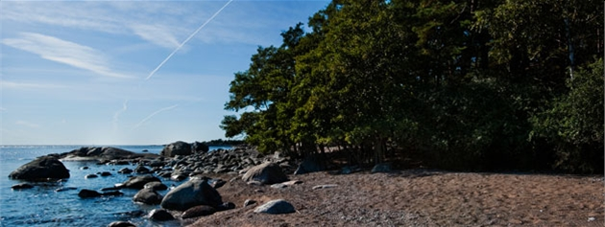
HERE ARE TODAY’S CLUES FROM GEOFFREY:
I separate the Scandinavian Peninsula from the main land of Europe
The Norse (Scandinavian) merchants built a trade empire around my coast and dominated my region during the Viking Age
The 3 countries on my eastern shore – Estonia, Latvia, and Lithuania – are nicknamed the “________ States”
During the winter, about 45% of my surface turns to ice
WHERE IN THE WORLD IS GEOFFREY?

Slide 6
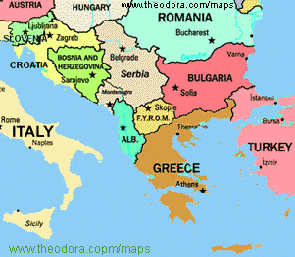
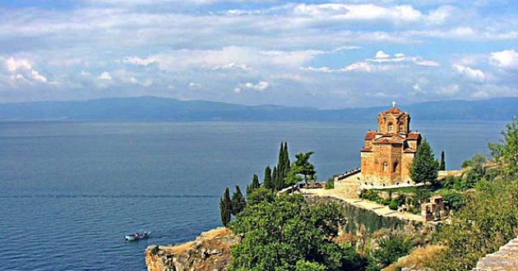
HERE ARE TODAY’S CLUES FROM GEOFFREY:
I am located in southeastern Europe
I am surrounded by the Adriatic Sea, the Mediterranean Sea, and the Aegean Sea
Countries located on me include Albania, Bosnia and Herzegovinia, Greece, Kosovo, Serbia, and the eastern part of Turkey
I am very mountainous and have dense forest areas
WHERE IN THE WORLD IS GEOFFREY?

Slide 7
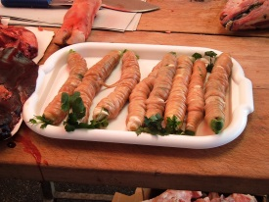
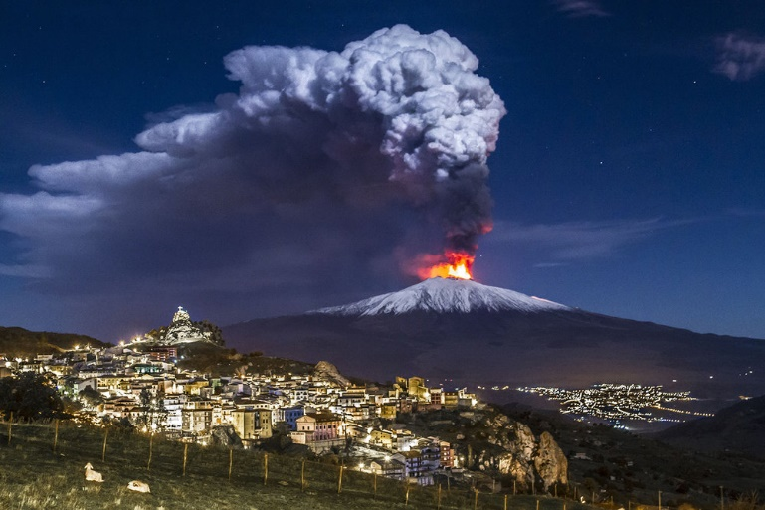
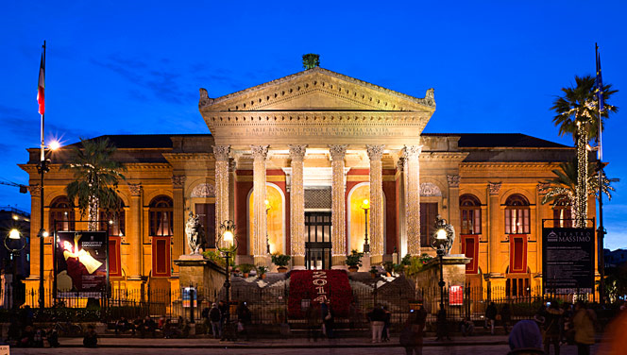
HERE ARE TODAY’S CLUES FROM GEOFFREY:
I am located in the Mediterranean Sea
According to Greek mythology, ships that pass between myself and Calabria are in danger of being attacked by the sea monsters, Scylla and Charybdis
My capital, Palermo, has been elected the European capital of street food
I am home to a large active volcano named Etna
The largest Italian opera house, Teatre Massimo, is located on my island
WHERE IN THE WORLD IS GEOFFREY?

Slide 8
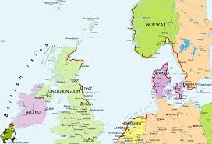
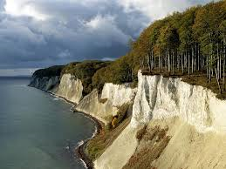
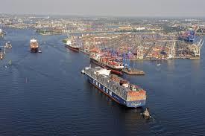
HERE ARE TODAY’S CLUES FROM GEOFFREY:
I border the Scandinavian Peninsula and the British Isles
I am a shallow sea with a depth of less than 150 feet in some areas
I am one of the busiest shipping areas in the world with my shores touching 7 European countries – Norway, Great Britain, Denmark, Germany, the Netherlands, Belgium and France
WHERE IN THE WORLD IS GEOFFREY?

Slide 9
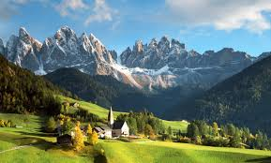
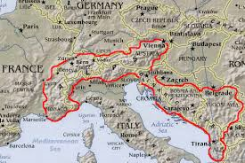
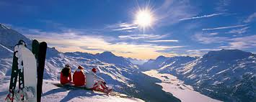
HERE ARE TODAY’S CLUES FROM GEOFFREY:
I stretch through France, Italy, Switzerland, and Austria
My high, snow-capped peaks are known throughout the world for their beauty
Mont Blanc is my tallest mountain at 15,781 feet high
Three of Europe’s largest rivers – the Rhine, the Rhone, and the Po – start in my mountains
WHERE IN THE WORLD IS GEOFFREY?

Slide 10
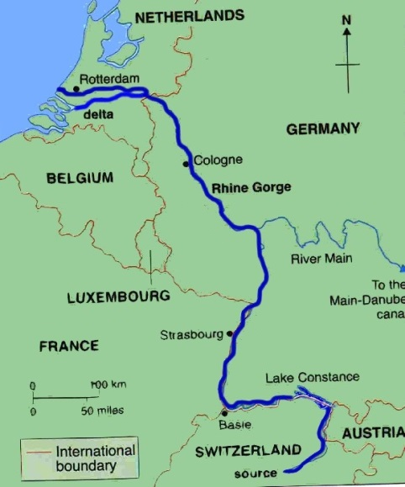
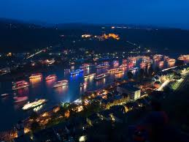
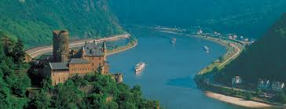
HERE ARE TODAY’S CLUES FROM GEOFFREY:
I begin in the Swiss Alps at the Rheinwaldhoen Glacier
I flow through 6 countries – Switzerland, Liechtenstein, Austria, Germany, France, and the Netherlands – before reaching the North Sea
More than 40 castles and fortresses, that were built during the Middle Ages, are along my banks
I have been one of Europe’s most important transport routes since the Roman Empire
WHERE IN THE WORLD IS GEOFFREY?

Slide 11
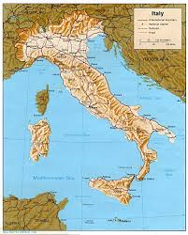
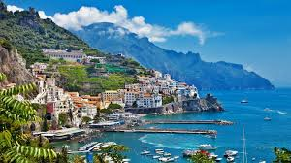
HERE ARE TODAY’S CLUES FROM GEOFFREY:
I am a boot-shaped peninsula in Southern Europe
Italy is the major country located on me
The smaller countries of Vatican City and San Marino are also located on me
I am surrounded by the Adriatic Sea, Ionian Sea, and the Mediterranean Sea
WHERE IN THE WORLD IS GEOFFREY?

Slide 12
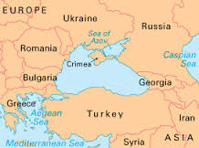
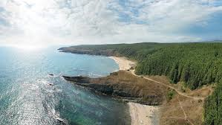
HERE ARE TODAY’S CLUES FROM GEOFFREY:
I am located between southeastern Europe and western Asia
I border the European countries of Bulgaria, Romania, Ukraine, and Russia and the Asian countries of Turkey and Georgia
The Yalta Convention about WWII, between Churchill, FDR, and Stalin, was held in the city of Yalta on my northern coast
I was a busy waterway in the ancient world, with the Balkans to my west, Central Asia to my east, Mesopotamia to my south, and Greece to my southwest
WHERE IN THE WORLD IS GEOFFREY?

Slide 13
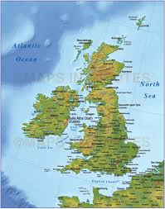
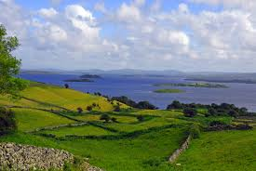
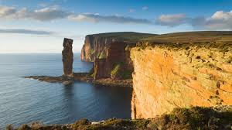
HERE ARE TODAY’S CLUES FROM GEOFFREY:
I consist of two main islands, the United Kingdom and Ireland, as well as thousands of smaller islands
In the north and west there are mostly mountains, plateaus and valleys
In the south there are low hills and plains
Ireland, often called the Emerald Isle, is an island known for its lush green land and cool, rainy weather
WHERE IN THE WORLD IS GEOFFREY?

Slide 14
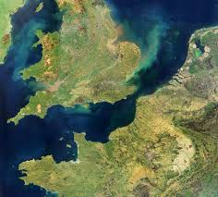
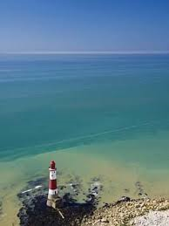
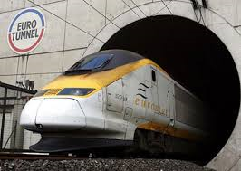
HERE ARE TODAY’S CLUES FROM GEOFFREY:
I separate Great Britain from France and connect the North Sea to the Atlantic Ocean
I am the busiest commercial waterway in the world, with ferries, freighters, and fishing boats
I have a rail tunnel – nicknamed the “Chunnel” – built underwater connecting England and France for travelers
WHERE IN THE WORLD IS GEOFFREY?

Slide 15
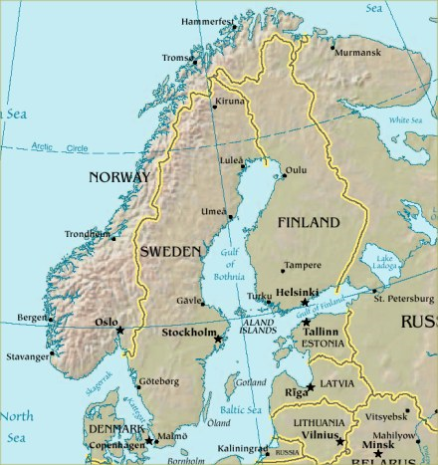
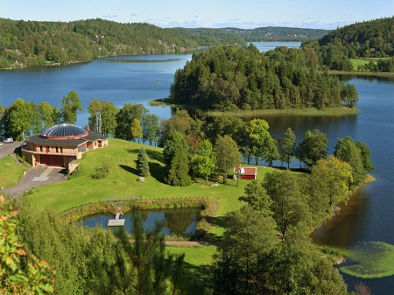
HERE ARE TODAY’S CLUES FROM GEOFFREY:
I am located in northern Europe
I include the countries of Norway and Sweden, as well as a small part of Finland
I am surrounded by the Baltic Sea, North Sea, and the Norwegian Sea
25% of my land is located north of the Arctic Circle
WHERE IN THE WORLD IS GEOFFREY?

Slide 16
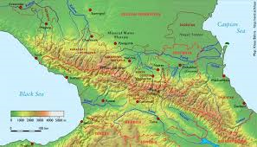
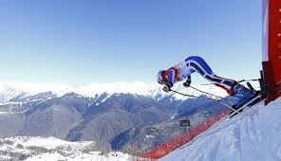
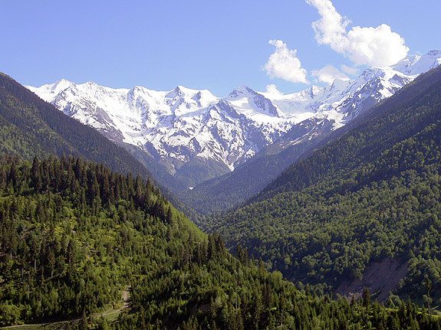
HERE ARE TODAY’S CLUES FROM GEOFFREY:
I am located along the border between southeastern Russia and the Asian countries of Azerbaijan and Georgia
Mount Elbrus, the highest mountain in Europe, is in my mountain range
Some of my mountains hosted events for the Sochi Olympic Games
My region is culturally divers, with several ethnic groups that developed in relative isolation due to the difficult conditions for travelers
WHERE IN THE WORLD IS GEOFFREY?

Slide 17
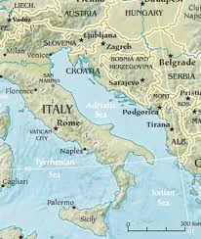
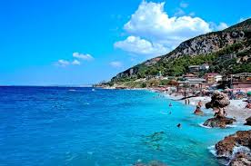
HERE ARE TODAY’S CLUES FROM GEOFFREY:
I separate the Italian Peninsula from the Balkan Peninsula
My two major shorelines have a striking contrast, with the Italian coast being relatively straight with no islands, and the Croatian coast being more rugged and full of both large and small islands
Bari, Rijeka, and Venice are come of my chief ports, and my sea is very well served by regional ferries
WHERE IN THE WORLD IS GEOFFREY?

Slide 18
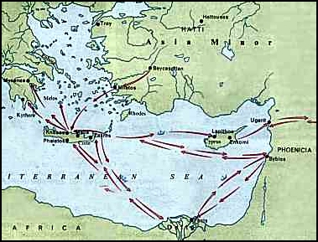
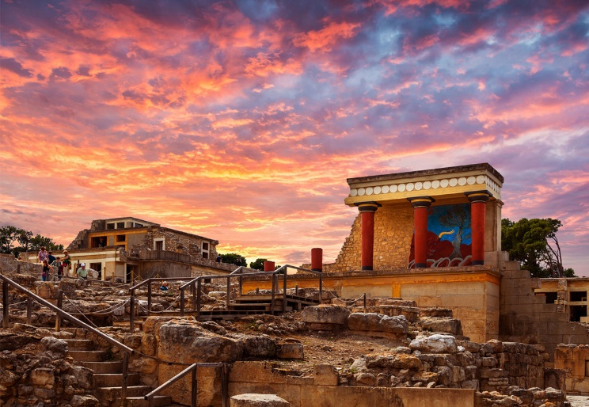
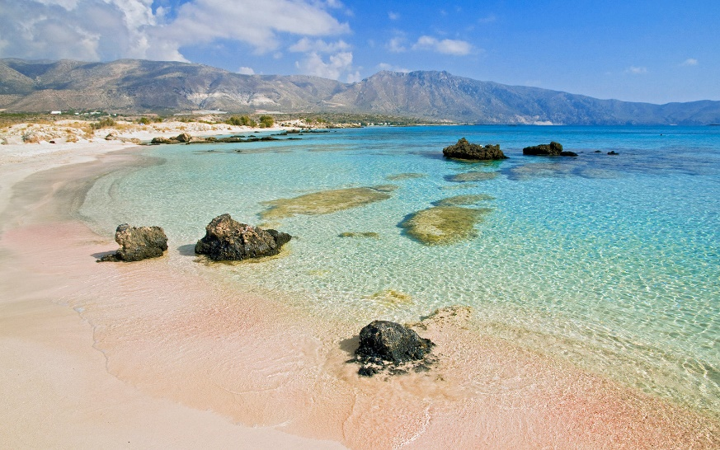
HERE ARE TODAY’S CLUES FROM GEOFFREY:
I am the largest of the Greek islands
I am an important place in Greek mythology, as I am believed to be the birthplace of Zeus as well as the home to the Minotaur and his labyrinth
My island is an important crossroad between Europe, Asia, and Africa, since I am located at an almost equal distance from all three continents
My waters are known as some of the clearest in Europe, and you can see over 40 meters down into the ocean
WHERE IN THE WORLD IS GEOFFREY?

Slide 19
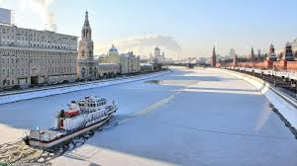
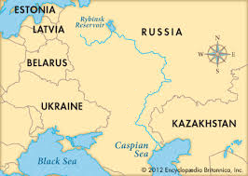
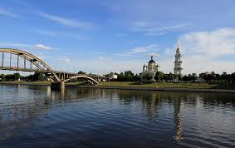
HERE ARE TODAY’S CLUES FROM GEOFFREY:
I flow through much of European Russia and played a significant role in Russian history and culture
I empty into the Caspian Sea and am Europe’s longest river
Several of Russia’s largest cities, including the capital Moscow, are located near my banks
Most of my length in the north is frozen over for three months during the winter
WHERE IN THE WORLD IS GEOFFREY?

Slide 20
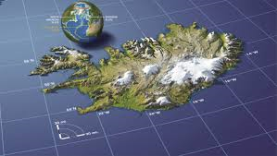
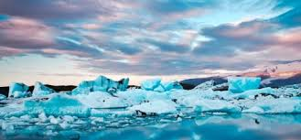
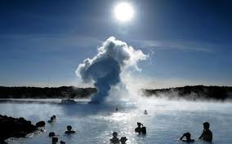
HERE ARE TODAY’S CLUES FROM GEOFFREY:
I am located in the North Atlantic Ocean
I am actually the top of an underwater volcano – my island formed from hot lave that cooled and turned to rock
I am known for my many volcanoes, hot springs, and geysers
Because I am so far north, I also have several glaciers – but grassy lowlands stretch along my coasts
WHERE IN THE WORLD IS GEOFFREY?

Slide 21
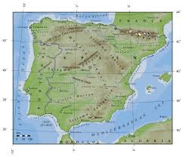
HERE ARE TODAY’S CLUES FROM GEOFFREY:
I am located on the southwestern tip of Europe
Countries on me include Spain, Portugal, and Andorra
I am surrounded by the Bay of Biscay, the Atlantic Ocean, and the Mediterranean Sea
They Pyrenees form a land barrier in the northeast that separated me from the rest of Europe
I am only 5 miles away from Africa at its nearest point
WHERE IN THE WORLD IS GEOFFREY?

Slide 22
HERE ARE TODAY’S CLUES FROM GEOFFREY:
I am almost completely surrounded by land with coastlines in 21 countries
Europe is to my north, Asia is to my east, and Africa is to my south
I am connected to the Atlantic Ocean by the Strait of Gibraltar
I have several islands in my waters, including Crete, Cyprus, Malta, and Sicily
WHERE IN THE WORLD IS GEOFFREY?

Slide 23
HERE ARE TODAY’S CLUES FROM GEOFFREY:
I stretch between France and Spain and separate the Iberian Peninsula from the rest of Europe
My mountain chain is about 270 miles long and 80 miles wide
Blocked by my mountains from the rest of Europe, Spain and Portugal developed stronger ties to Africa and the sea
The small country of Andorra lies among my peaks
WHERE IN THE WORLD IS GEOFFREY?

