Slide 1
Where in the World
North American Physical Features

Slide 2
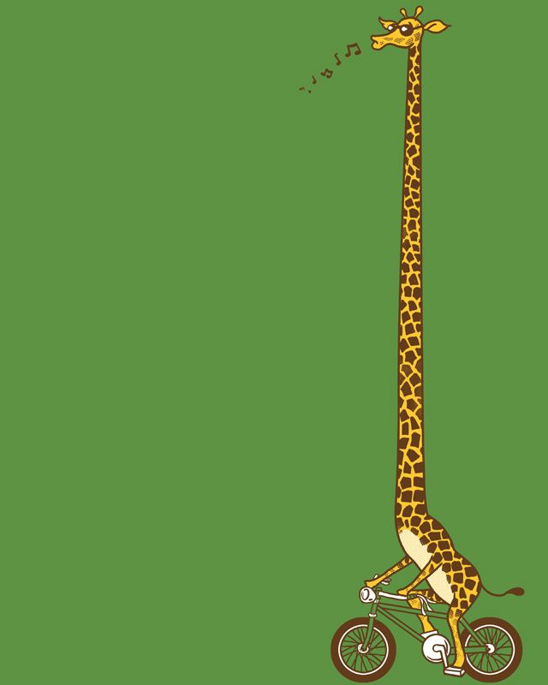
Geoffrey,
our lovable geography giraffe,
has decided to take a tour of North American
Physical Features.
He is going to send us clues and pictures of his various stops to help us test our geographical skills.

Slide 3
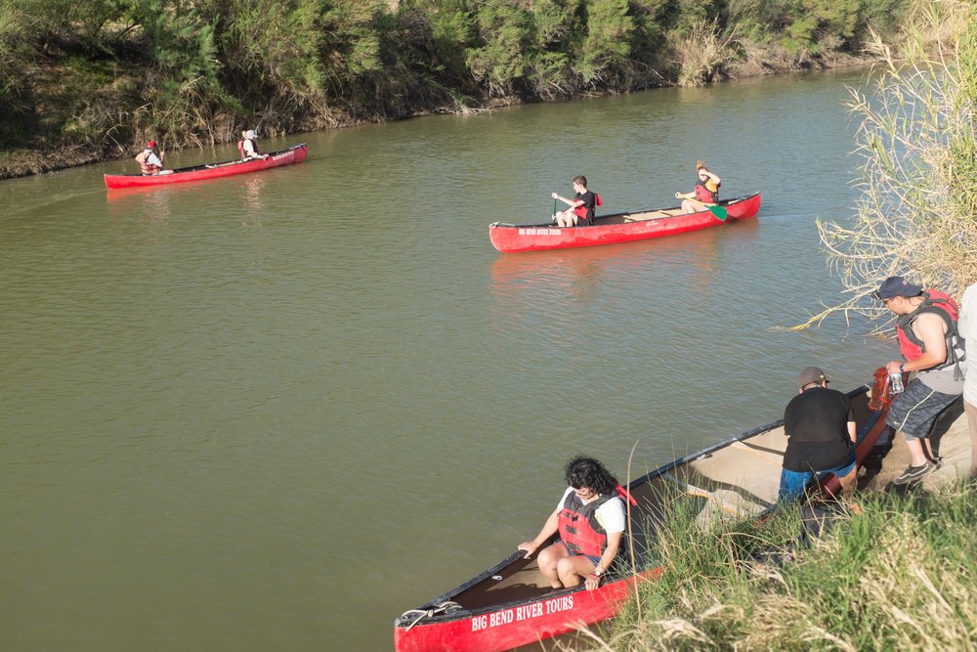
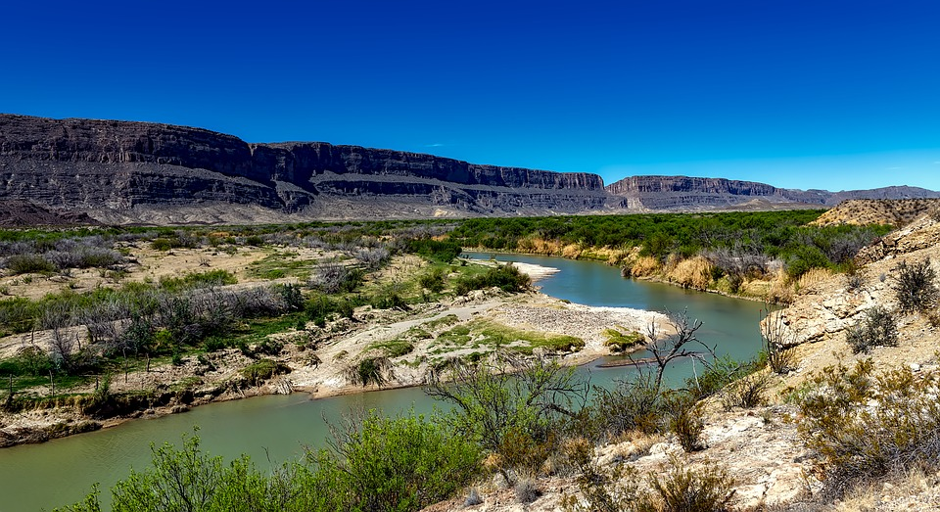
HERE ARE TODAY’S CLUES FROM GEOFFREY:
I serve as the natural border between the US and Mexico
My name means “Big River,” but I am not large enough to be navigable by oceangoing ships. I am limited to canoes and rafts.
I flow from south central Colorado to the Gulf of Mexico
WHERE IN THE WORLD IS GEOFFREY?

Slide 4
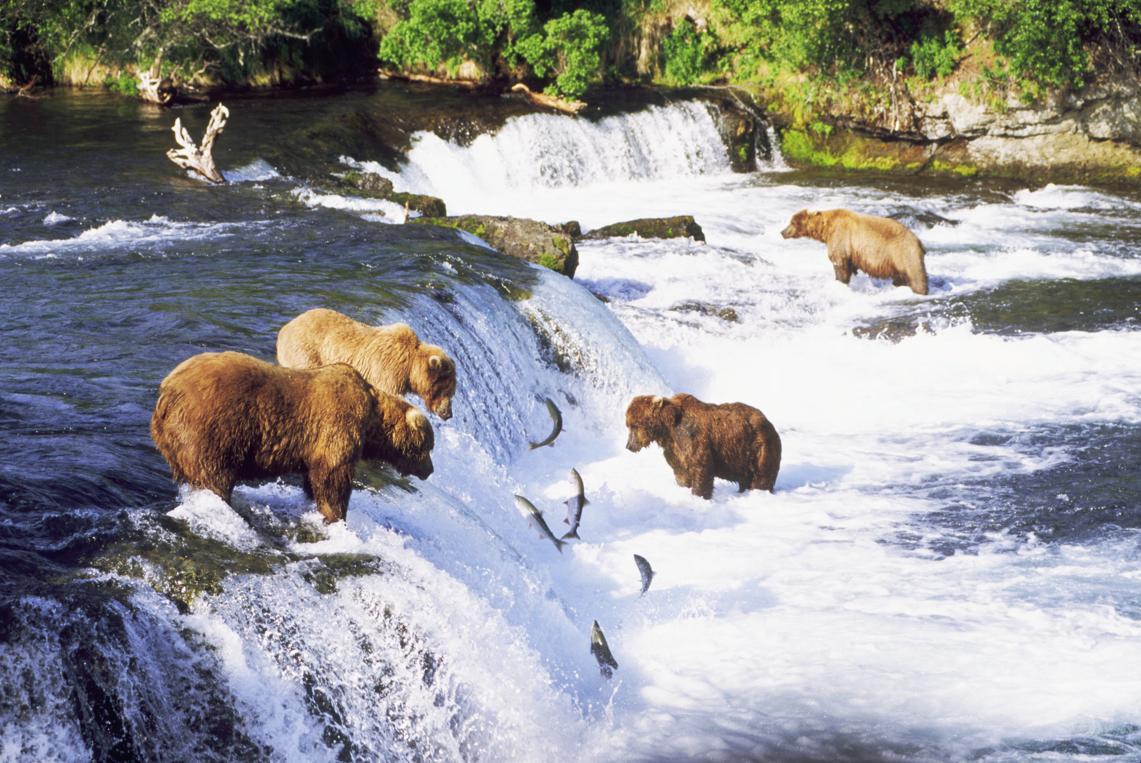
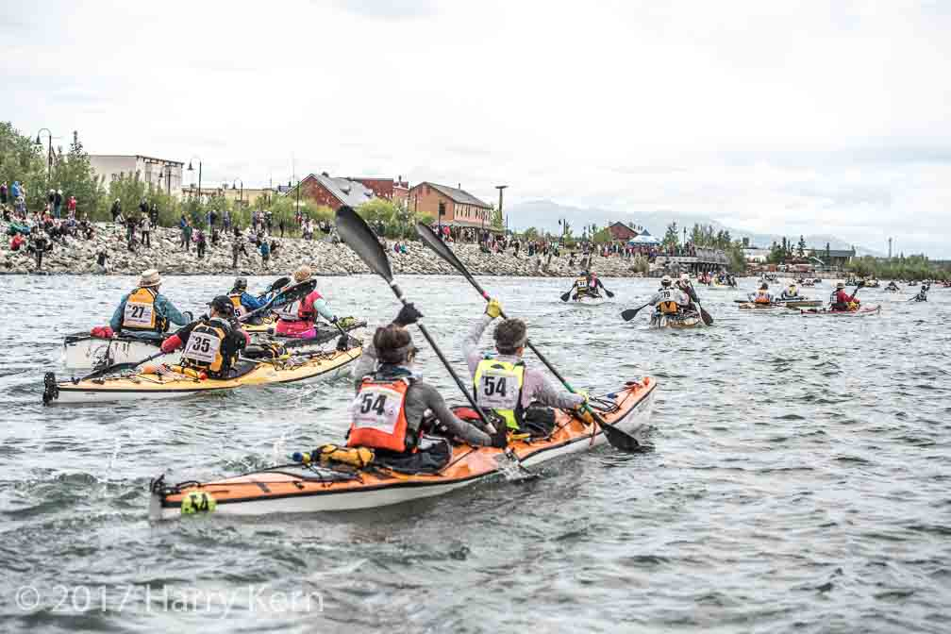
HERE ARE TODAY’S CLUES FROM GEOFFREY:
I am the 3rd largest river in North America
I flow from British Columbia, through the Yukon Territory and Alaska to the Bering Sea
I am one of the most important salmon-breeding rivers in the world.
The world’s longest annual canoe and kayak race is held in my waters each year.
I was a principle form of transportation during the Klondike Gold Rush.
WHERE IN THE WORLD IS GEOFFREY?

Slide 5
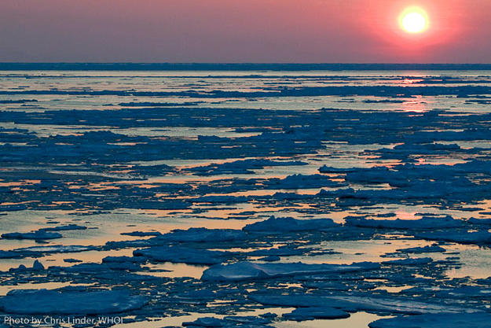
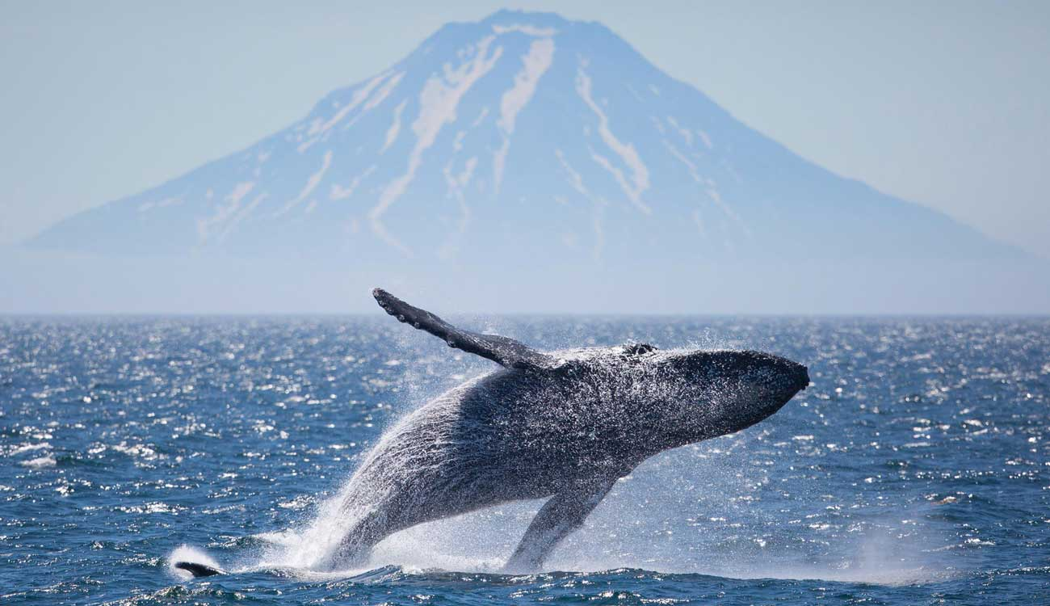
HERE ARE TODAY’S CLUES FROM GEOFFREY:
Scientists believe that during the Ice Age, my sea level was low enough to allow humans and animals to migrate from Asia to North America by crossing me
You will find many endangered whale species in my waters, including the rarest in the world, the North Pacific Right Whale
My ecosystem is under the jurisdiction of both the United States and Russia
I am named after Virtus Bering, the explorer who first spotted the Alaskan mainland
WHERE IN THE WORLD IS GEOFFREY?

Slide 6
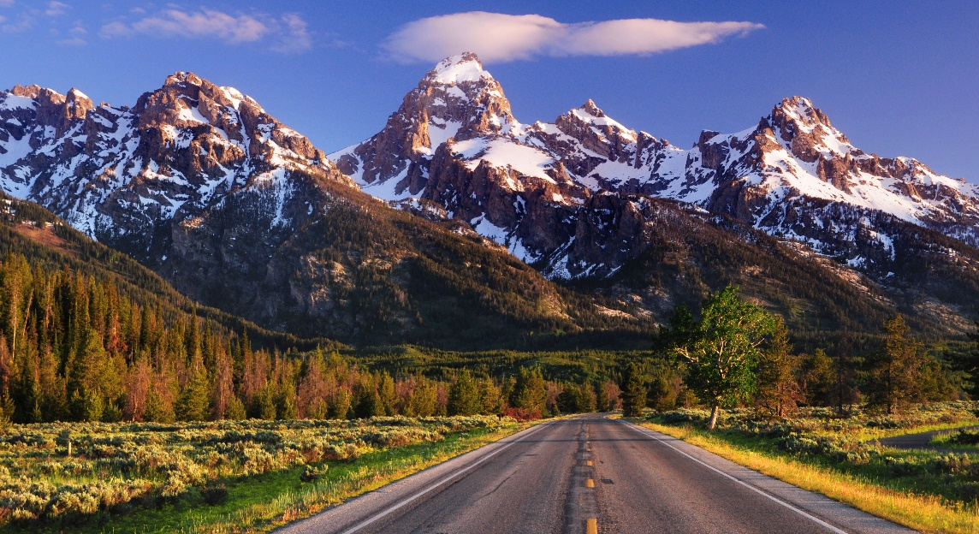
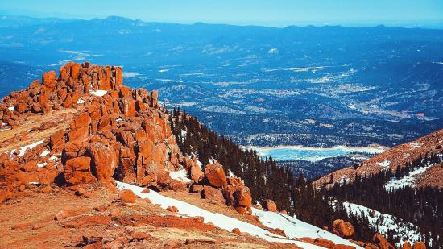
HERE ARE TODAY’S CLUES FROM GEOFFREY:
I am the largest mountain system in North America stretching for more than 3000 miles from Canada through the western half of the United States
I form the Continental Divide, which means the rivers on my west flow west into the Pacific Ocean and my rivers on the east flow east into the Atlantic Ocean
I am home to Pikes Peak, the 2nd most visited mountain peak in the world.
WHERE IN THE WORLD IS GEOFFREY?

Slide 7
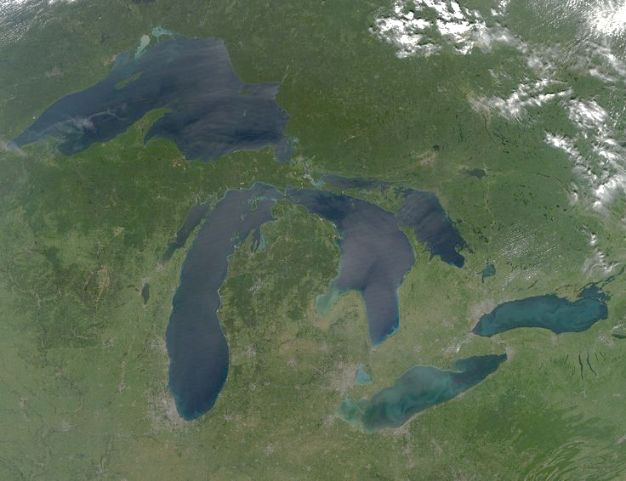
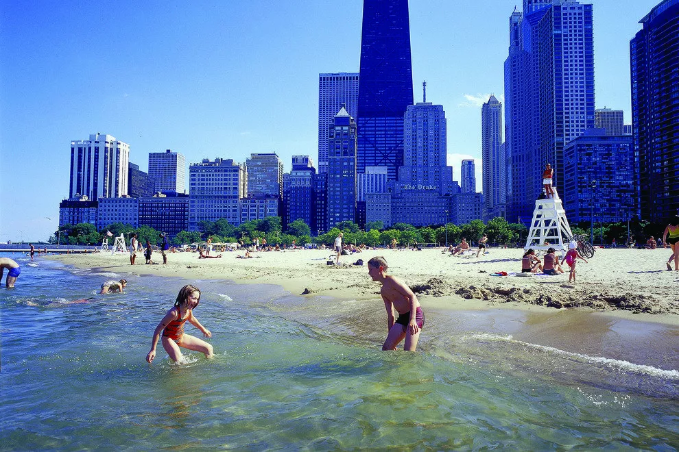
HERE ARE TODAY’S CLUES FROM GEOFFREY:
I am located on the border between Canada and the United States
I was formed during the last ice age when melting glaciers left large basins in the land that filled with water
I hold about one-fifth of the world’s fresh water supply
I am part of the St. Lawrence Seaway, which allows goods to be shipped easily from the central portion of North America to the Atlantic Ocean
WHERE IN THE WORLD IS GEOFFREY?

Slide 8
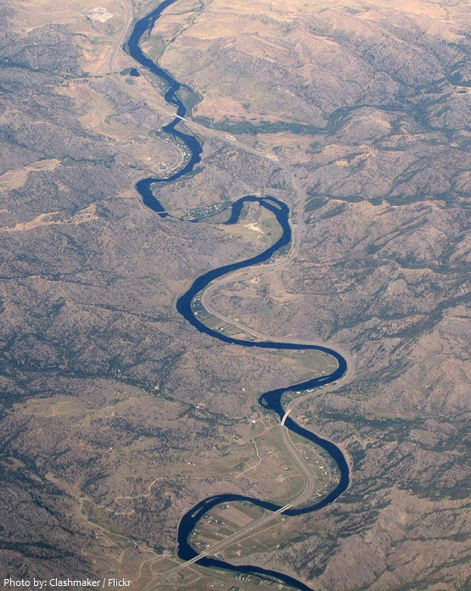
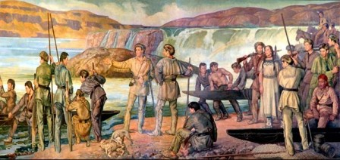
HERE ARE TODAY’S CLUES FROM GEOFFREY:
I am the longest river in North America and the 15th largest river in the world
I begin in Montana and flow through several states before reaching the Mississippi River just north of St. Louis
In 1804, my waters were explored by Meriwether Lewis and William Clark
I am home to over 150 species of fish and around 300 different species of birds.
WHERE IN THE WORLD IS GEOFFREY?

Slide 9
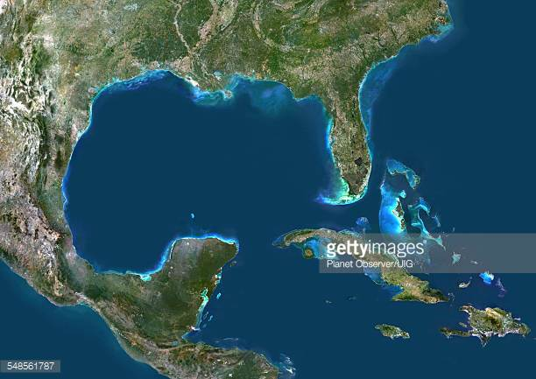
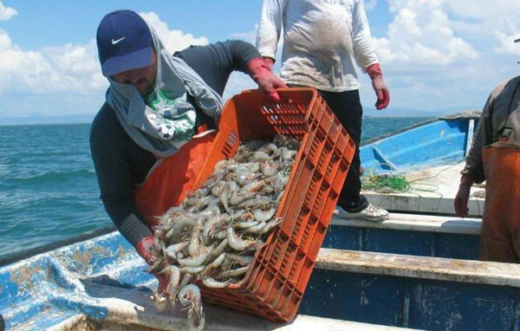
HERE ARE TODAY’S CLUES FROM GEOFFREY:
I am a large body of water located on the southeastern coast of the United States
33 major rivers flow into me, including the Mississippi River
Hurricanes are common in my waters, especially between the months of June and November
There are several large fishing ports along my coasts, and shrimp and oysters are a major product in my waters
WHERE IN THE WORLD IS GEOFFREY?

Slide 10
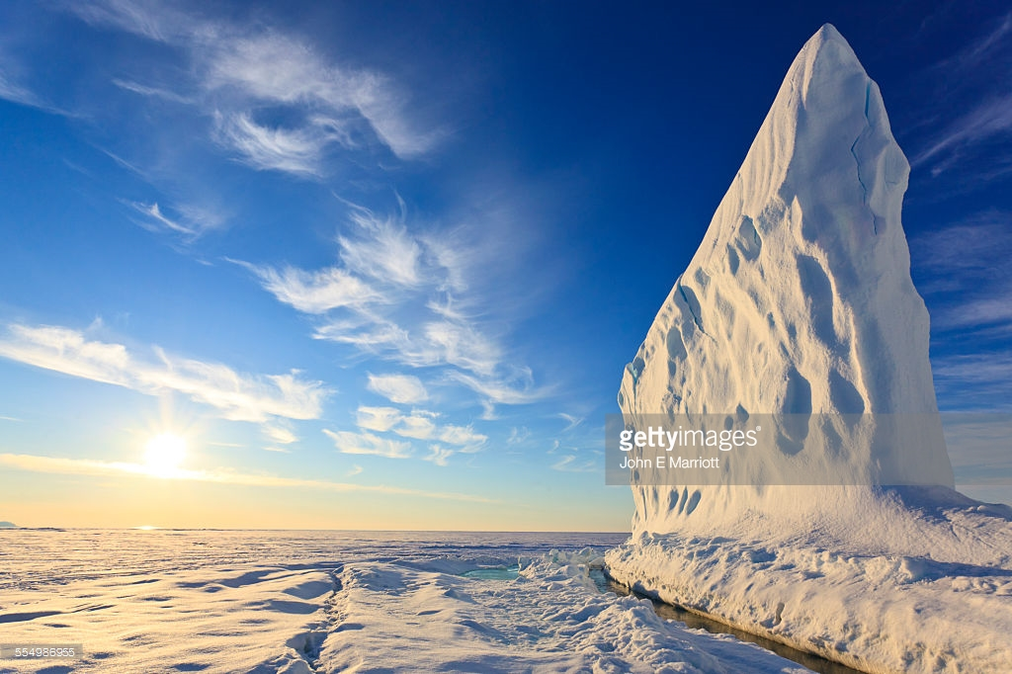
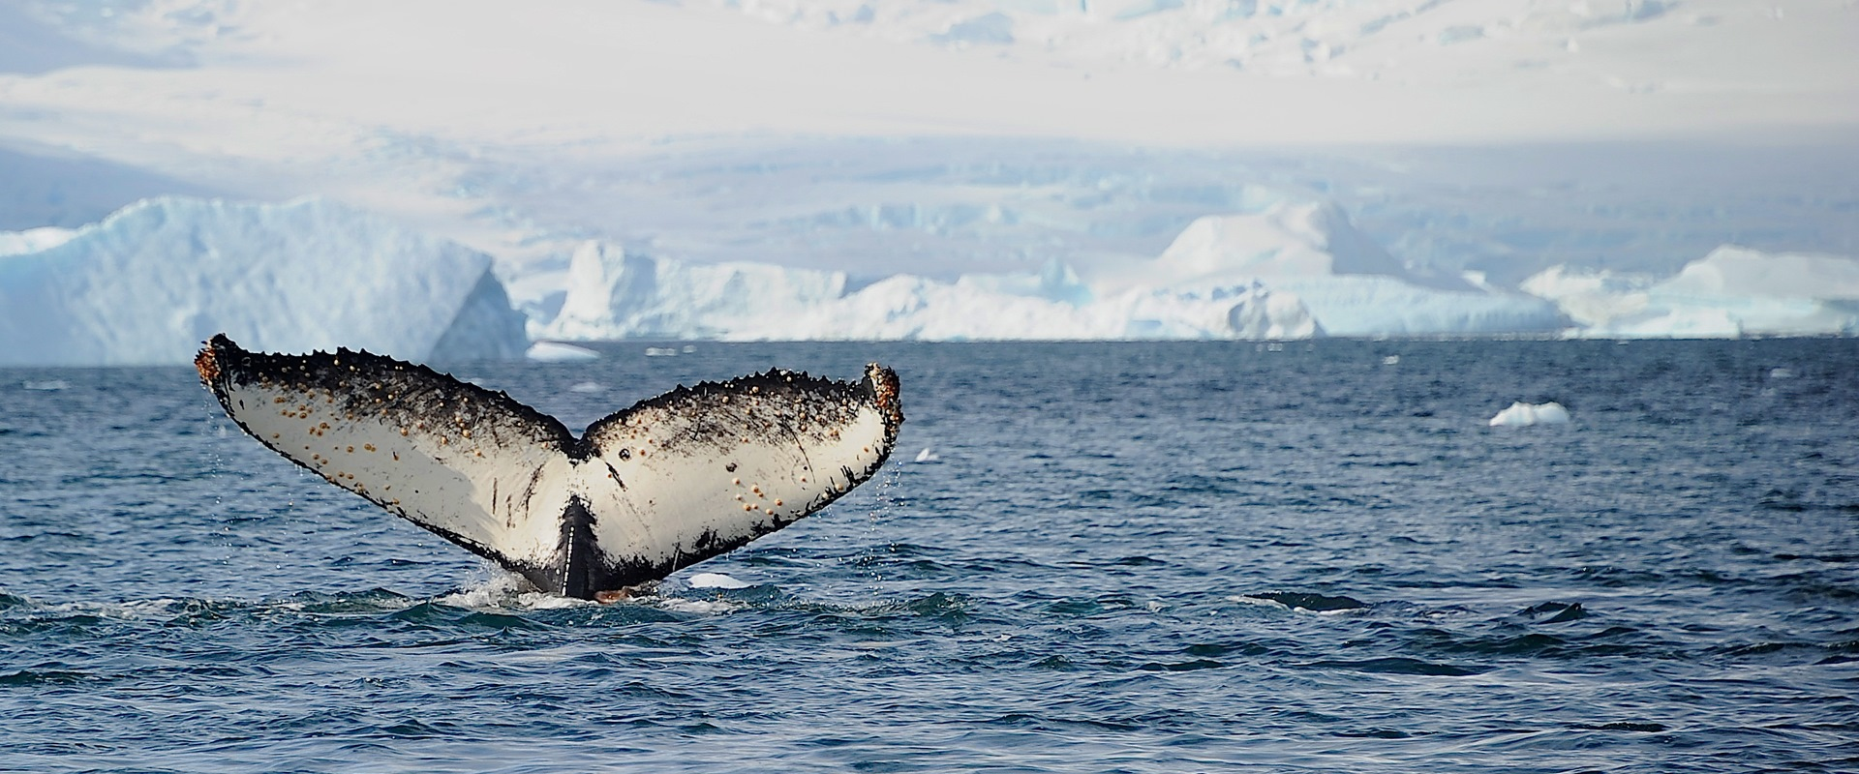
HERE ARE TODAY’S CLUES FROM GEOFFREY:
I am located between the islands of northern Canada and Greenland
For most of the year, people cannot travel on my waters because they are covered with ice and numerous large icebergs
My waters are home to many animals, including Beluga whales, walruses, narwhals, and several species of seals.
A few Inuit tribes live along my shores and are the only ones who fish in my dangerous waters
WHERE IN THE WORLD IS GEOFFREY?

Slide 11
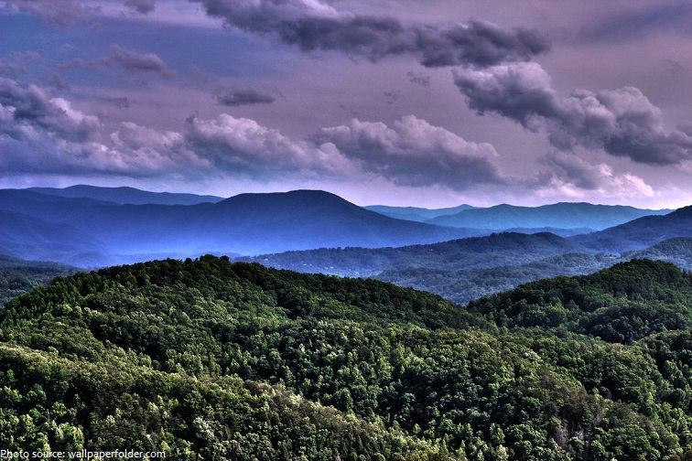
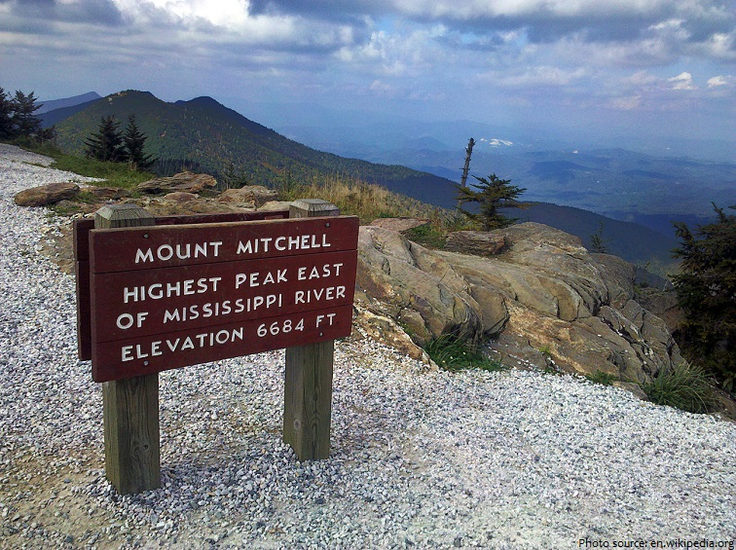
HERE ARE TODAY’S CLUES FROM GEOFFREY:
I am the oldest mountain chain in North America, forming around 480 millions years ago
I am located in the eastern part of the US, spreading southwest from Canada into Alabama.
My highest peak is Mount Mitchell, which is also the highest point east of the Mississippi River
I contain large deposits of coal, petroleum, and natural gas
I am home to 8 national forests and 6 major national parks, and am a popular destination for hikers.
WHERE IN THE WORLD IS GEOFFREY?

Slide 12
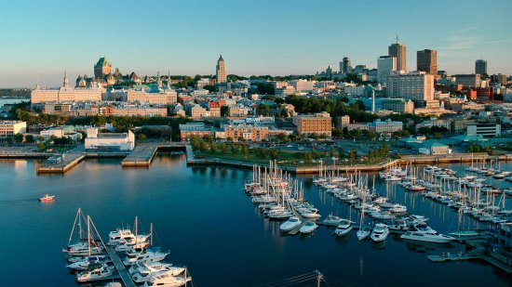
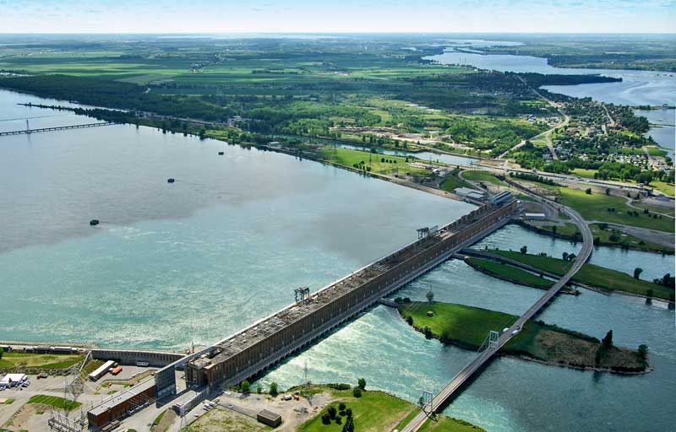
HERE ARE TODAY’S CLUES FROM GEOFFREY:
I connect the Great Lakes to the Atlantic Ocean and am an important waterway for shipping goods.
I was discovered by Jacques Cartier in 1534 during his search for the Northwest Passage
Canals have been constructed around my rapids to make my waters more easy to navigate
I am an important source for hydroelectric power, and the Beauharnois Power Plant near Montreal is one of the largest in the world
WHERE IN THE WORLD IS GEOFFREY?

Slide 13
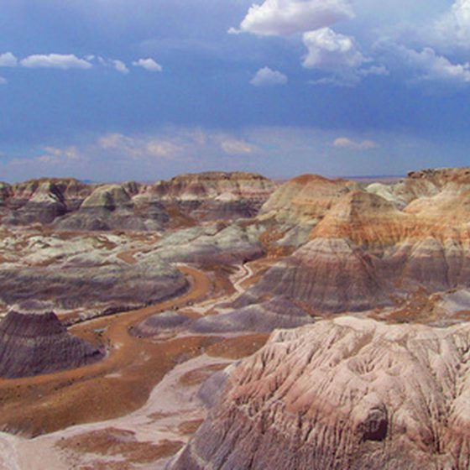
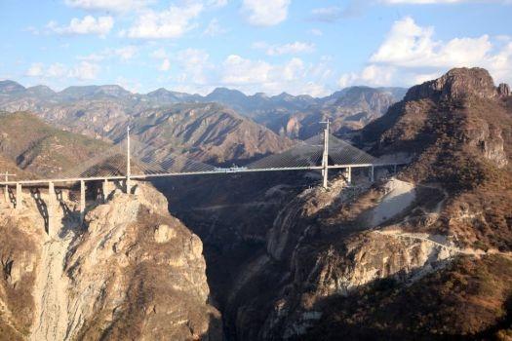
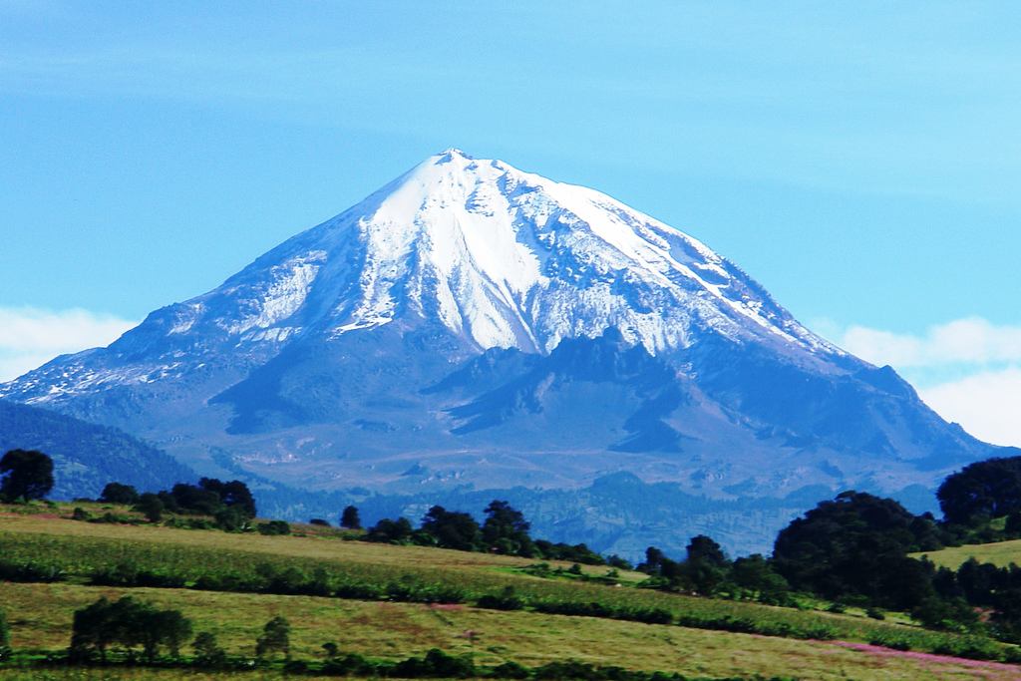
HERE ARE TODAY’S CLUES FROM GEOFFREY:
I consist of three small mountain ranges that spread across most of Mexico and Central America
My name in Spanish means “mother mountains”
My tallest peak, Pico de Orizaba, is actually a very large volcano
My mountains have served as a barrier between the eastern and western portions of Central America, and even today only a few paved roads link the two sides
WHERE IN THE WORLD IS GEOFFREY?

Slide 14
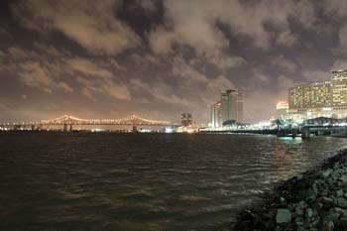
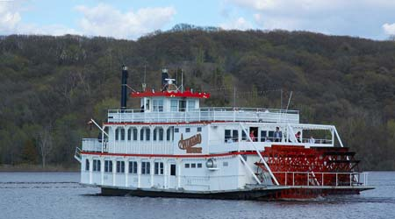
HERE ARE TODAY’S CLUES FROM GEOFFREY:
I flow from Lake Itasca in Minnesota and through ten states before reaching the Gulf of Mexico – and because of this I am a very important route for trade and travel
I am famous for the large paddle wheel steamboats that often sail on my waters
Several major cities in the US are along my banks, including New Orleans and St. Louis.
The first European to reach my waters was Hernando de Soto of Spain in 1541.
Many of Mark Twain’s famous stories are set along the banks of my river, including the Adventures of Huckleberry Finn.
WHERE IN THE WORLD IS GEOFFREY?

Slide 15
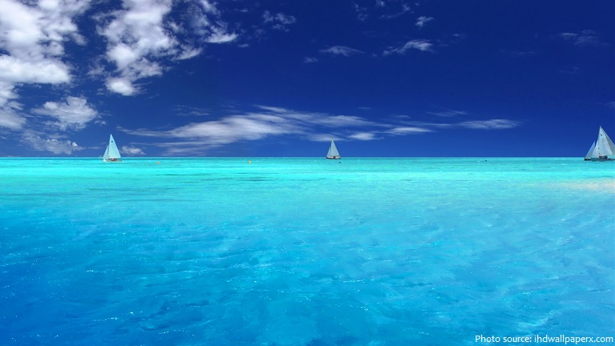
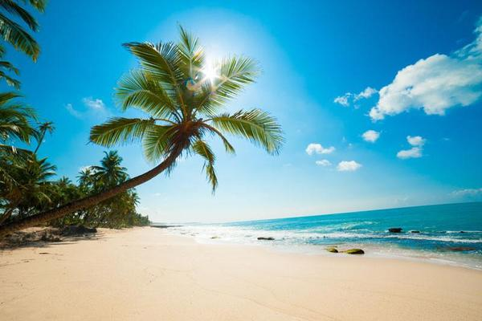
HERE ARE TODAY’S CLUES FROM GEOFFREY:
I am a tropical body of water off the eastern coast of Central America
My waters are home to over 7,000 islands, the largest of which is Cuba
I am a popular tourist destination due to my numerous beaches and warm waters all year
I was named after the Carib people, a Native American group that lived on many of my islands
During colonial time, many famous pirates sailed in my waters attacking merchant ships and travelers
WHERE IN THE WORLD IS GEOFFREY?

Slide 16
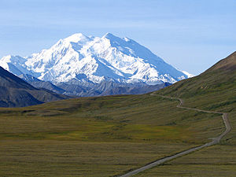
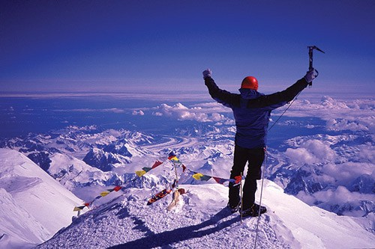
HERE ARE TODAY’S CLUES FROM GEOFFREY:
I am the highest mountain peak in North America
I am part of the Alaskan Mountain Range located in southern Alaska
I used to be named after President William McKinley, but my name was officially changed in 2015 by President Obama.
My official name means “high one,” and was a name given to me by the Athabascan people
WHERE IN THE WORLD IS GEOFFREY?

Slide 17
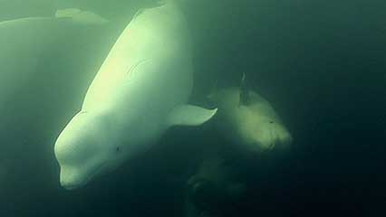
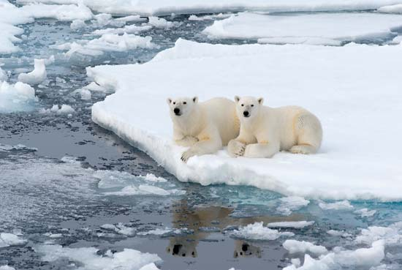
HERE ARE TODAY’S CLUES FROM GEOFFREY:
I am the 2nd largest bay in the world, and am located in northern Canada
I was named after the English explorer who discovered me while searching for the Northwest Passage
My waters are an important habitat for the Beluga Whales and there are even several Polar Bear sanctuaries along my coasts.
Very few people live near my waters, and they are mostly frozen except for a few months a year
WHERE IN THE WORLD IS GEOFFREY?

Slide 18
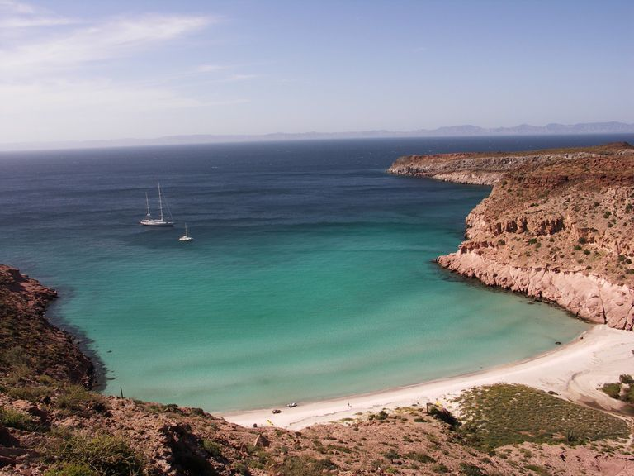
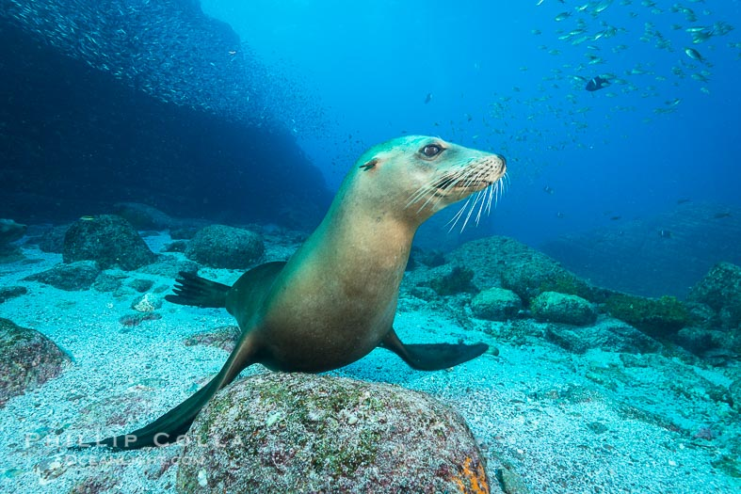
HERE ARE TODAY’S CLUES FROM GEOFFREY:
I am a long narrow peninsula that is surrounded by the Pacific Ocean and the Gulf of California
I am home to the western most state in Mexico, and some of my major cities are Mexicali, Tijuana, and San Felipe
My shores are home to 1/3 of the world’s marine mammals, and I am often called the “The World’s Aquarium”
WHERE IN THE WORLD IS GEOFFREY?

Slide 19
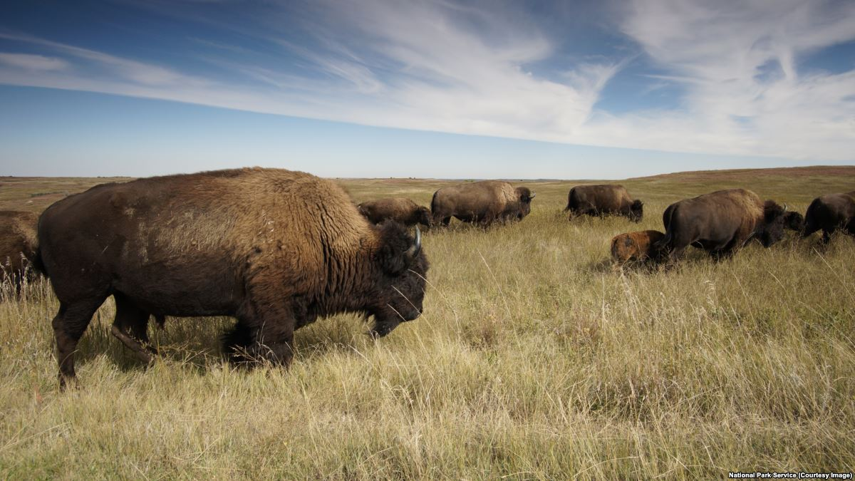
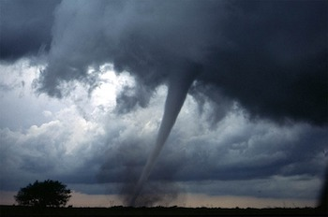
HERE ARE TODAY’S CLUES FROM GEOFFREY:
I stretch from Canada down to Mexico, cutting through the central part of the United States and bordered by the Rocky Mountains to the west and the Missouri River to the east
I am made up mostly of flat grasslands that are great for farming and raising animals
I was once home to over 60 million bison and numerous Native American tribes, but now only about 20,000 bison remain and most of the Native Americans have been relocated
Tornados are very common in my area.
WHERE IN THE WORLD IS GEOFFREY?

Slide 20
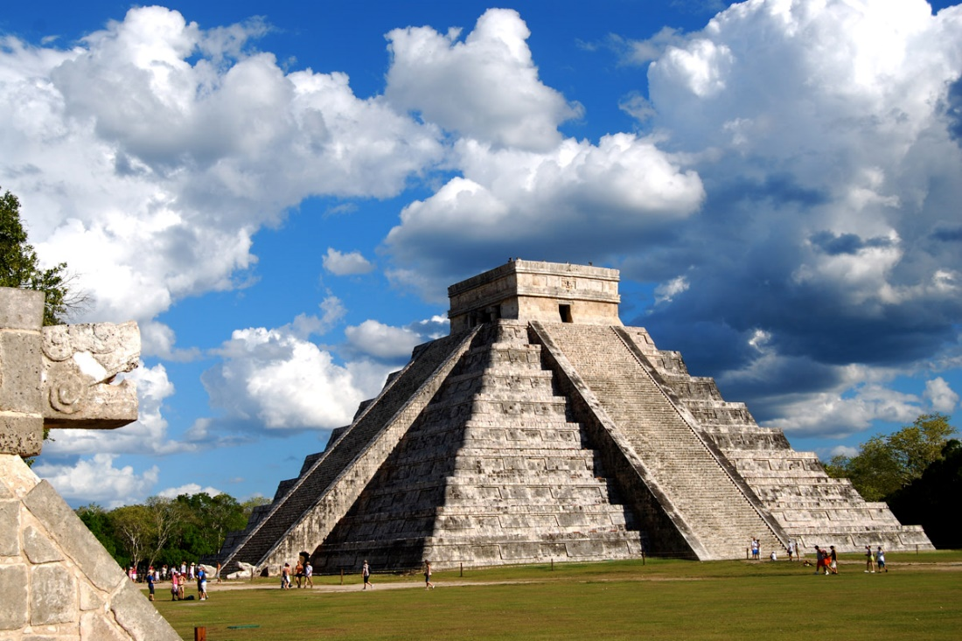
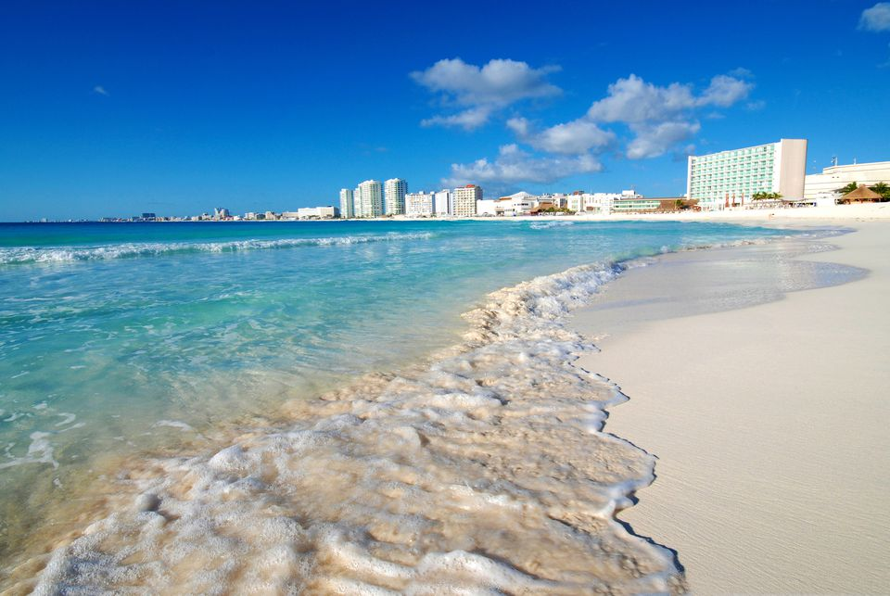
HERE ARE TODAY’S CLUES FROM GEOFFREY:
I am a peninsula located on the eastern side of Mexico that helps separate the Caribbean Sea from the Gulf of Mexico
I am home to the ruins of many ancient Mayan cities such as Chichen Itza
My coastlines include many famous tourist destinations such as Cancun and Cozumel
WHERE IN THE WORLD IS GEOFFREY?

Slide 21
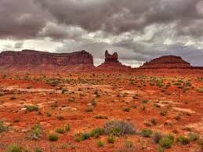
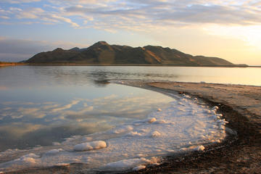
HERE ARE TODAY’S CLUES FROM GEOFFREY:
I am a large tract of lad in the western United States in which block of the earth’s crust have uplifted, sunk, and tilted – creating an almost bowl-like shape
I am a mostly desert region, receiving only 7 to 12 inches of precipitation each year
I am home to the Great Salt Lake which was formed due to my internal drainage system.
Reno and Salt Lake City are located in my region.
WHERE IN THE WORLD IS GEOFFREY?

Slide 22
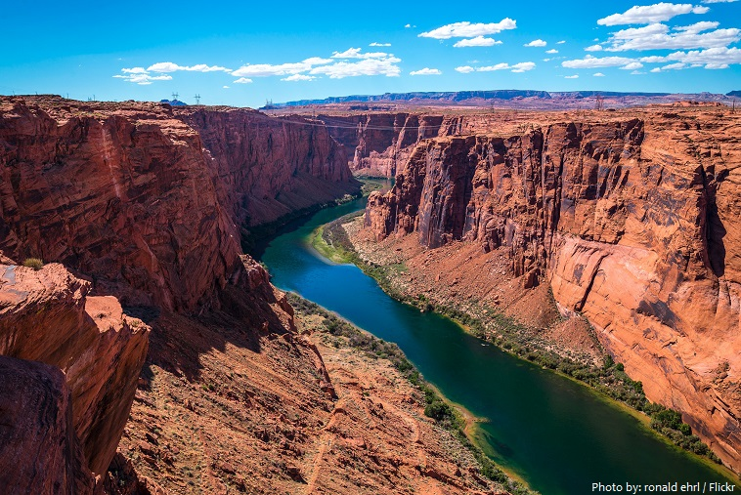
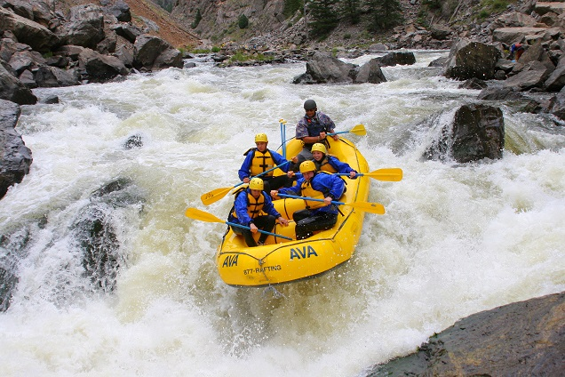
HERE ARE TODAY’S CLUES FROM GEOFFREY:
I begin in the Rocky Mountains and flow through seven states before entering the Gulf of California
Over the past 60 million years, my waters helped to carve out the Grand Canyon, which I still flow through today
There are several dams built along my waters, including the Hoover Dam which was built in 1935
The biggest sport along my waters is whitewater rafting
WHERE IN THE WORLD IS GEOFFREY?

